Slide 1
Gene transfer
Vertical
Horizontal
Transfer of genetic information including genetic mutation from one generation to the next
Genetic inheritance
Information carried by DNA
Helps in preserving advantageous genotypic and phenotypic characteristics of bacteria in subsequent generations
Information is also transferred within the cell in order to maintain physiological property of the cell and carry out metabolic activities
The movement of genetic information between organisms, that is not its offspring
also known as lateral gene transfer
acquiring new genetic traits as a result of mutation, a modification of gene function within a bacterium
The ability of Bacteria to adapt to new environments as a part of bacterial evolution results from the acquisition of new genes through horizontal gene transfer
e.g., the spread of antibiotic resistance genes among bacteria

Slide 2
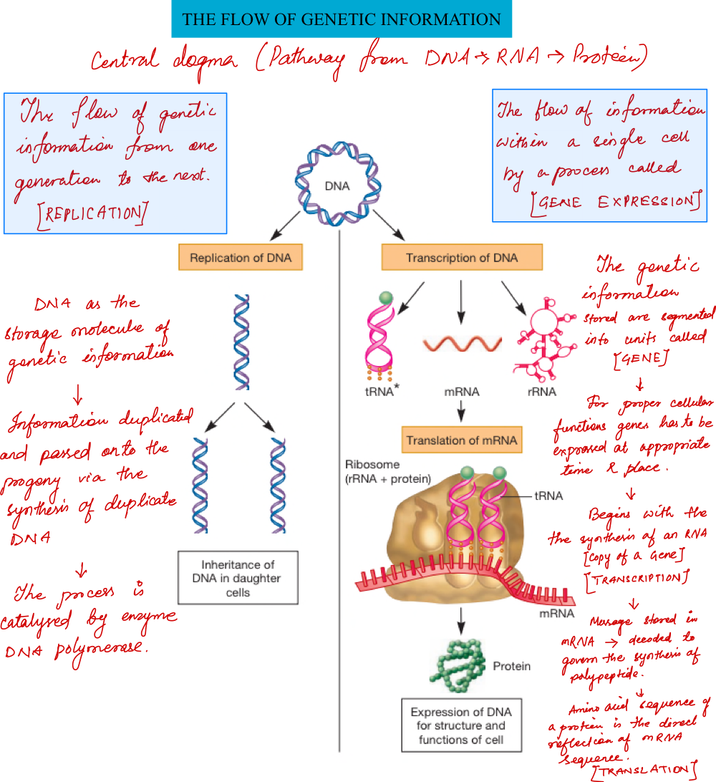

Slide 5
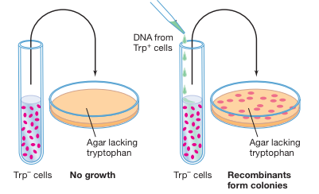

Slide 6
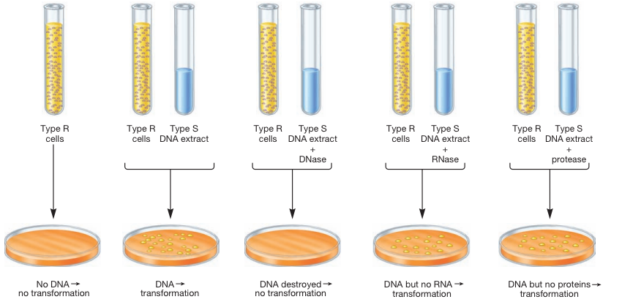
Oswald T. Avery’s biochemical study

Slide 7
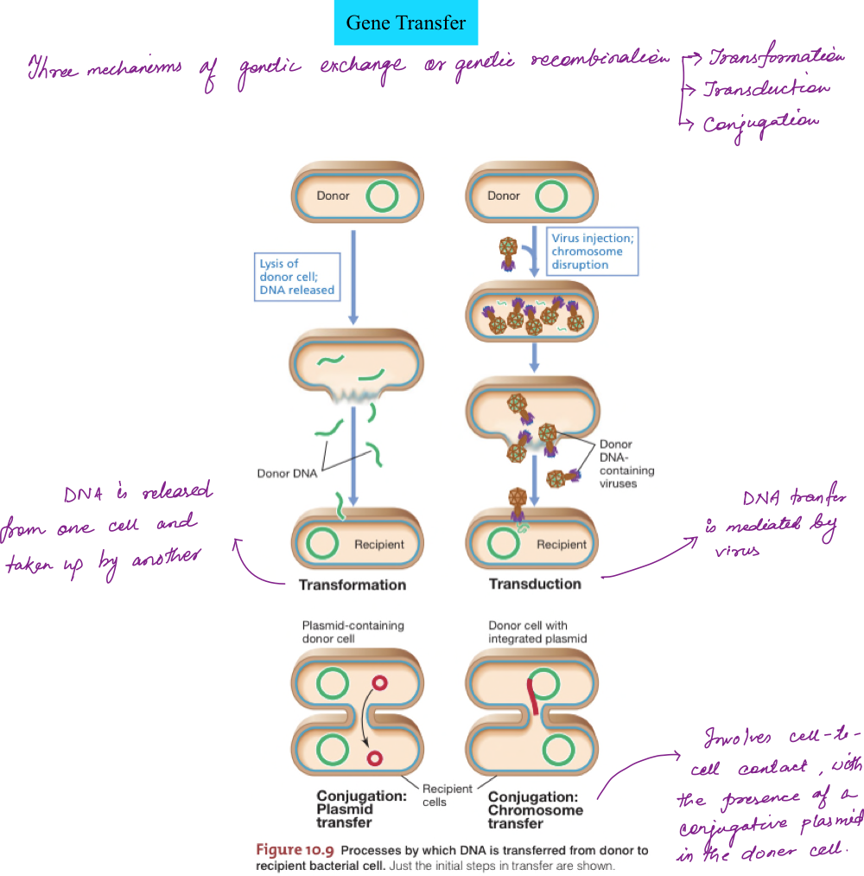
Genetic recombination in bacteria

Slide 8
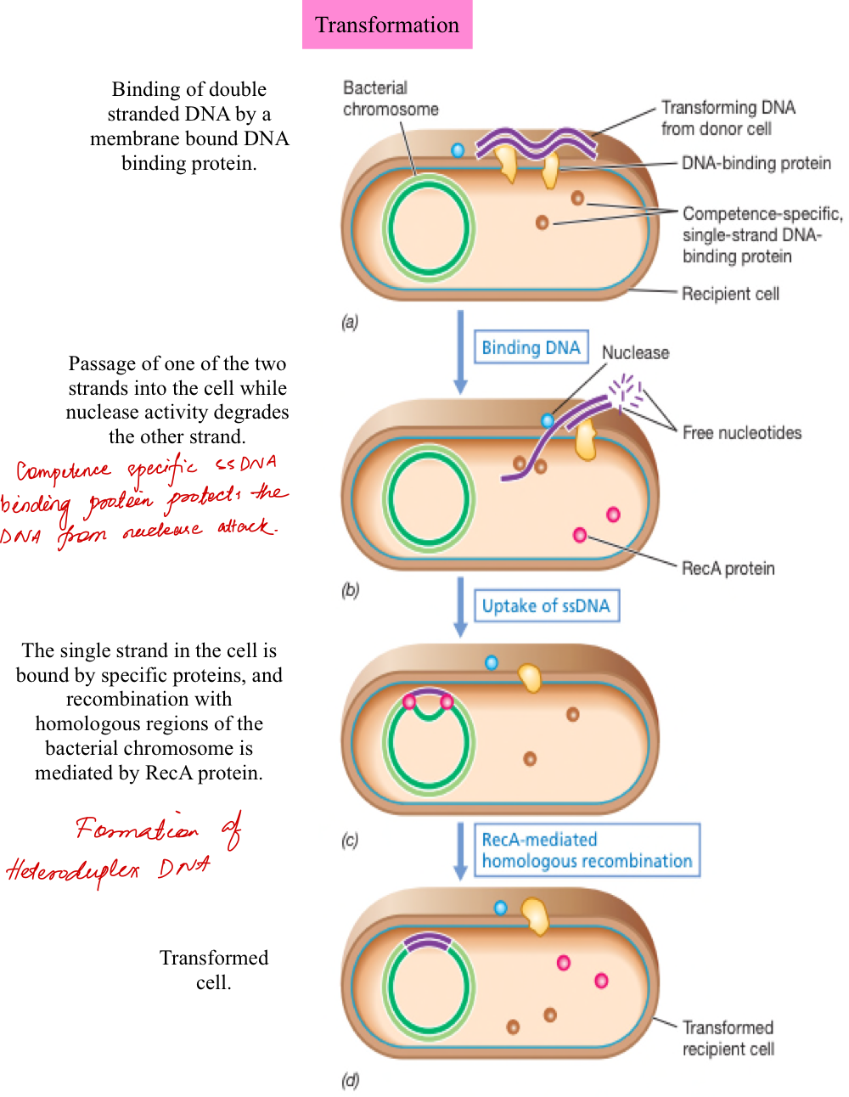
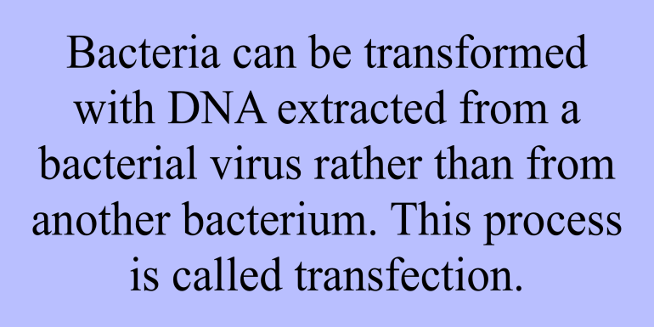

Slide 9
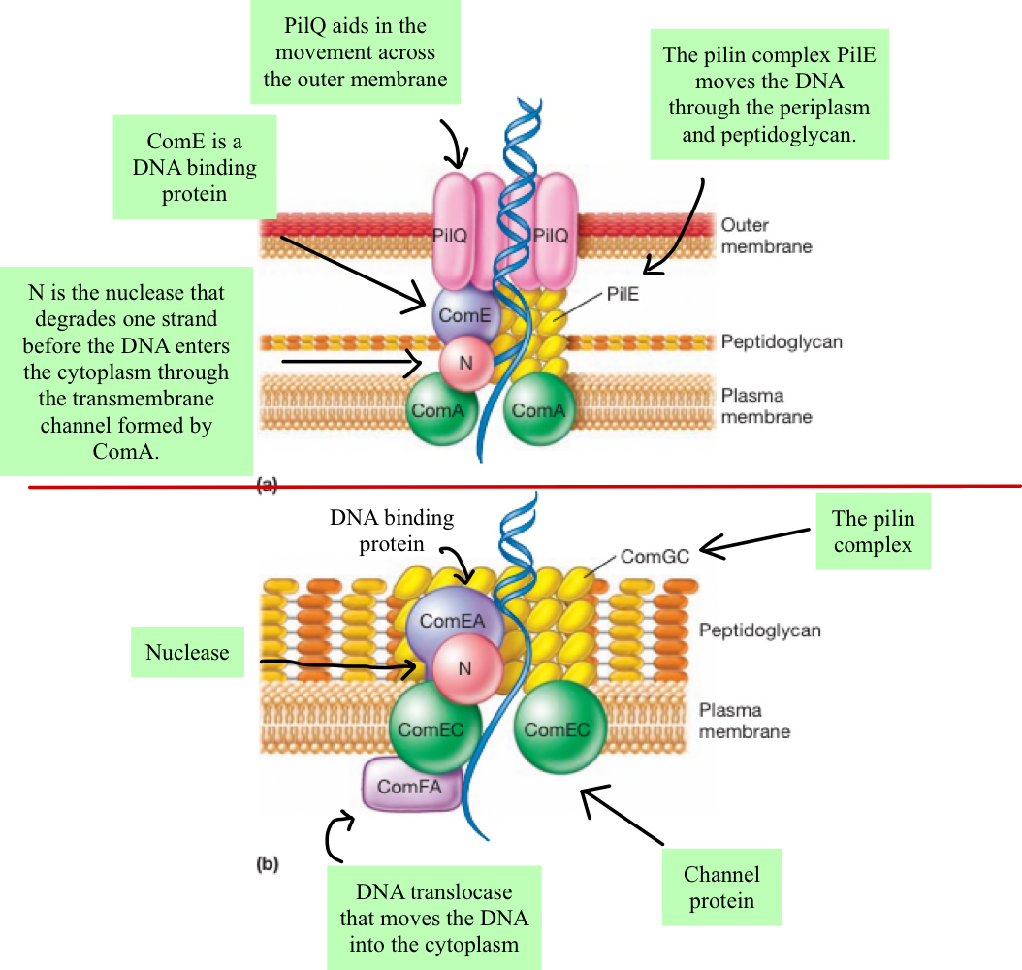
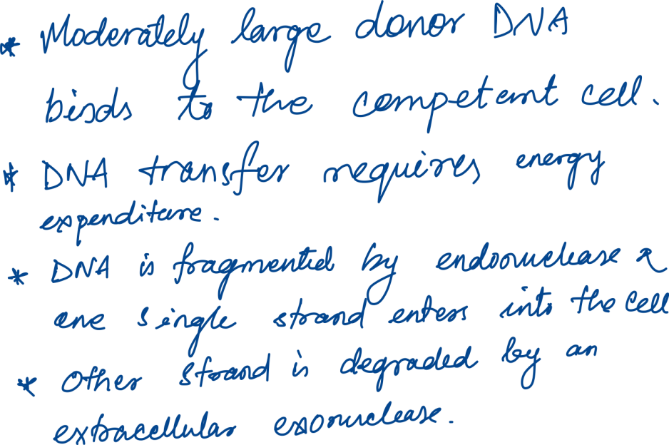

Slide 11
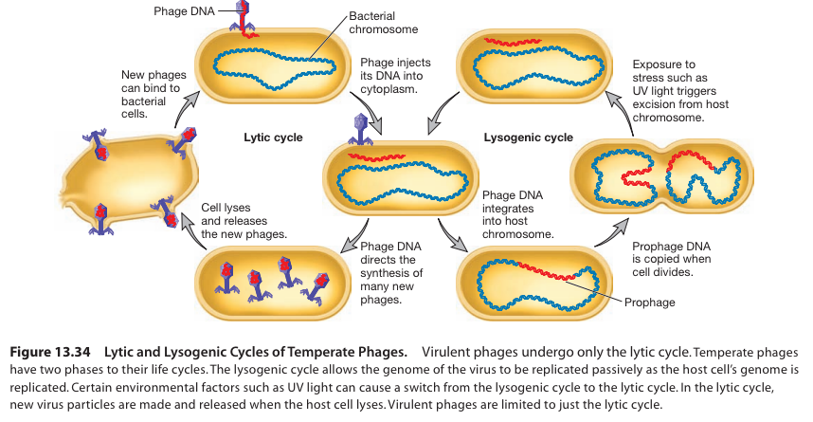

Slide 13
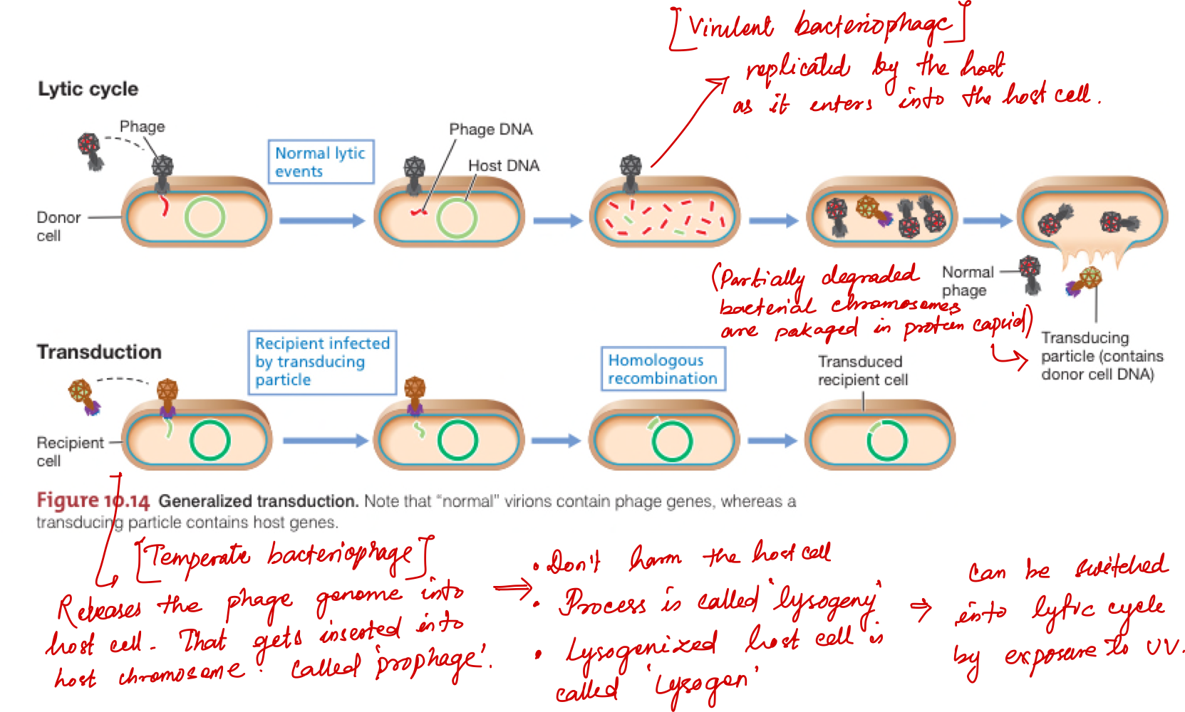

Slide 14
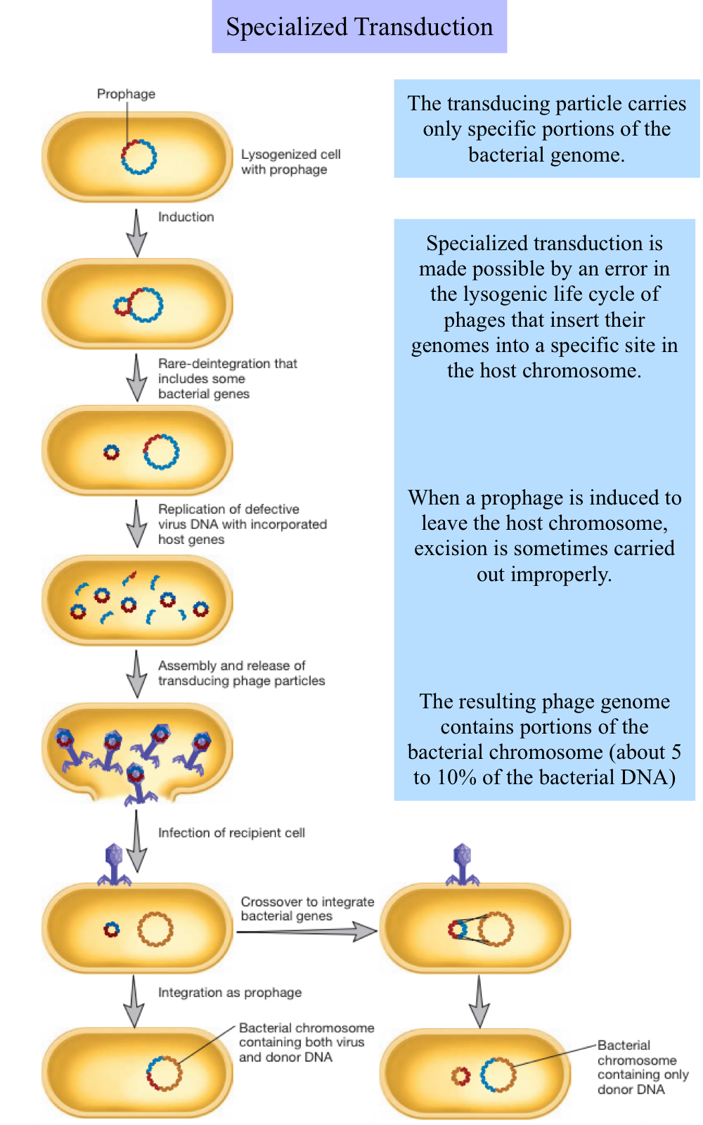

Slide 15
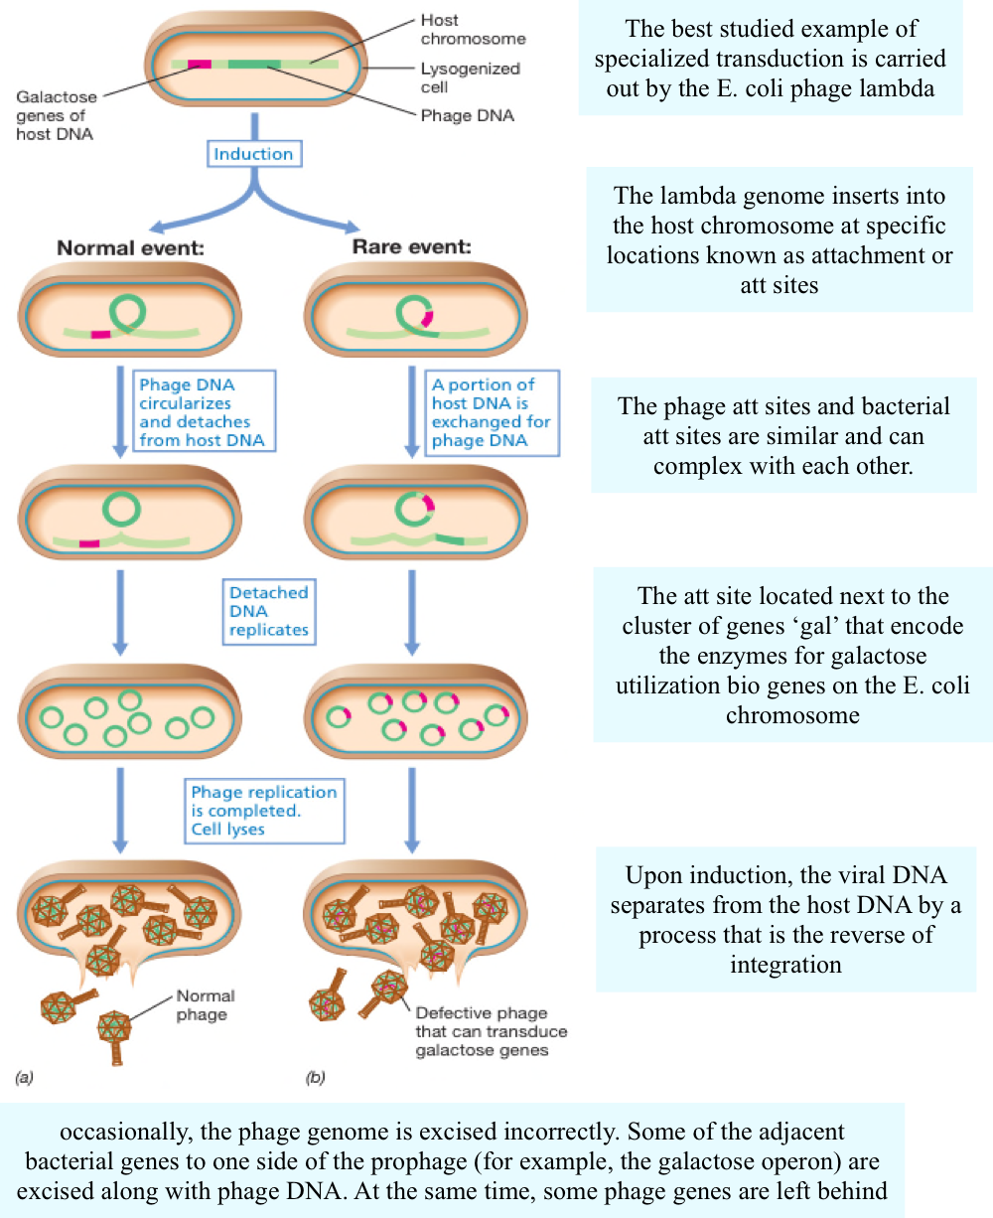

Slide 16
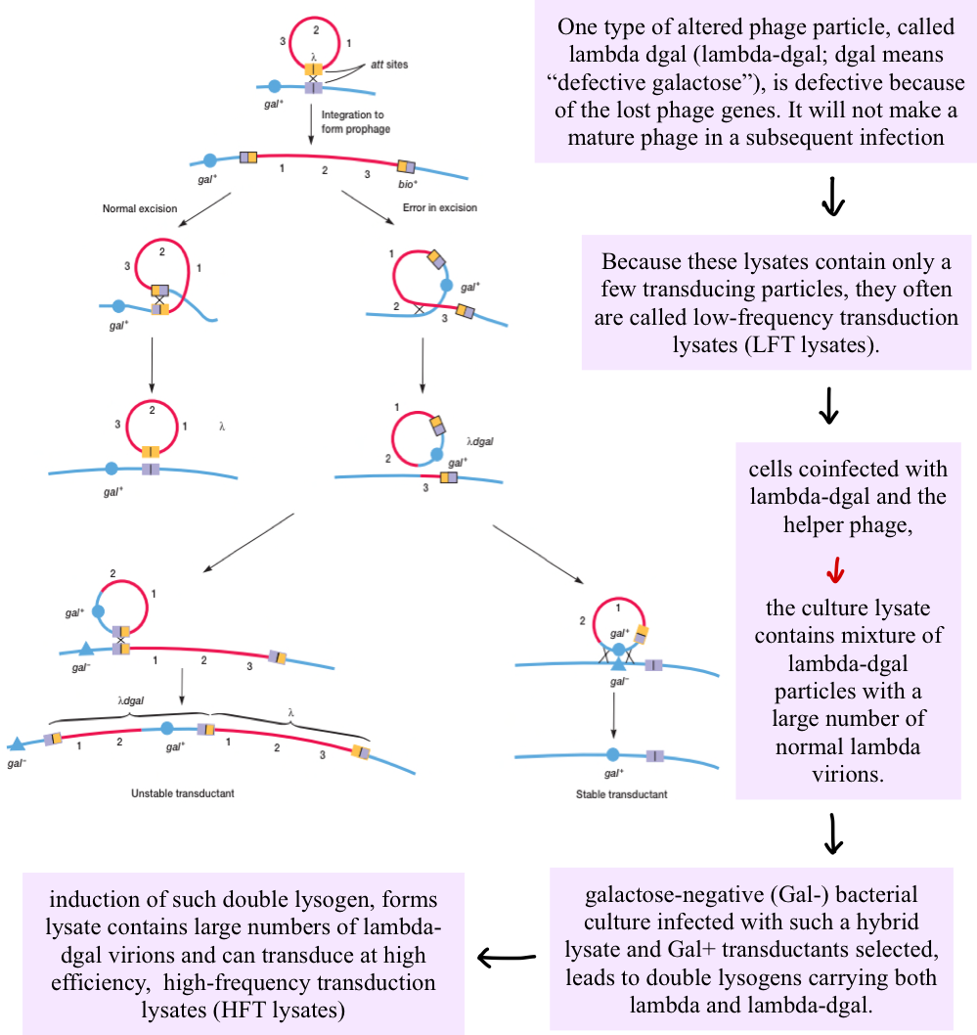

Slide 18
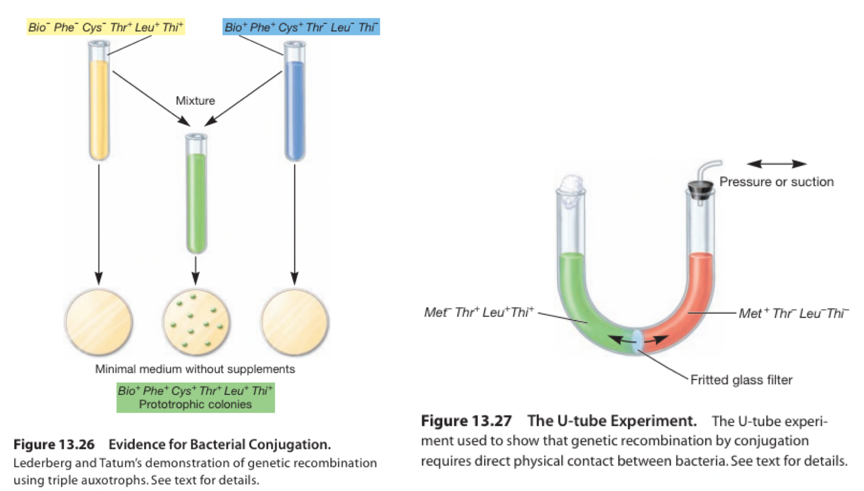

Slide 19
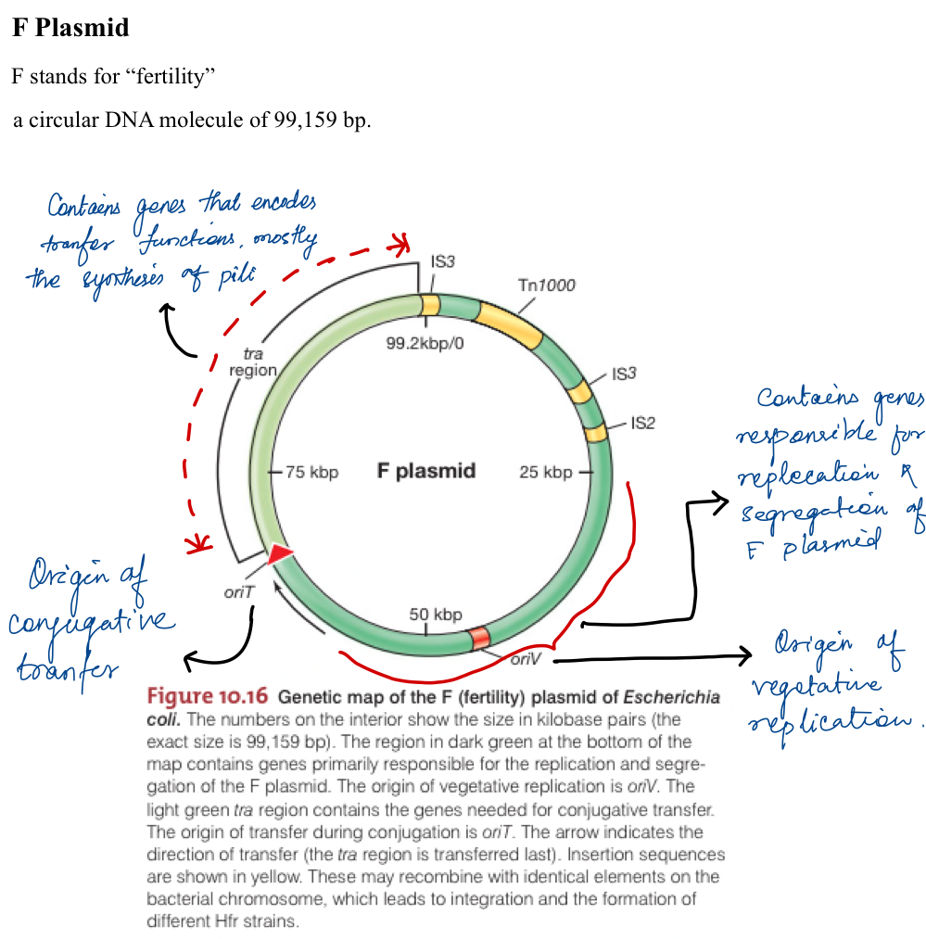

Slide 20
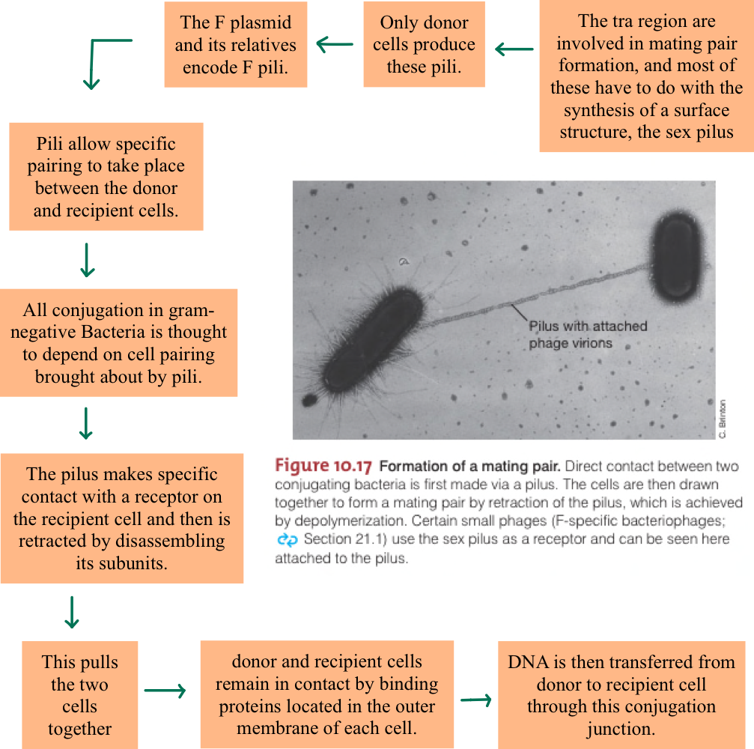

Slide 21
