Slide 1
Disaster Vulnerability and Risk Management
UNIT – III
GEOG3-FE05
Prepared By-
Dr. Rumana Khatun
Assistant Professor
P.G. Deptt. of Geography
Utkal University, Vani Vihar, Bhubaneswar
@Copy Right

Slide 2
MEANING AND CONCEPT OF VULNERABILITY
The term vulnerability is derived from the Latin word ‘vulnere’ which means potential to be harmful or to be wounded to a condition of stress (Sahana 2018).
In a broader sense, it may also be defined as “the extent to which a community, structure, services or geographic area is likely to be damaged or disrupted by the impact of particular hazards on account of their nature, construction, and proximity to hazardous terrains or a disaster-prone area”.
The report of UNISDR, 2009 defines vulnerability as “the conditions determined by physical, social, economic and environmental factors or processes, which increase the susceptibility of a community to the impact of hazards.”

Slide 3
There are some possible criteria for vulnerable situations due to hazardous events. These are as follows:
Proximity to a possible hazardous event.
The population density of that particular area during an extreme event.
Less-scientific observation of the hazards.
Lack of public awareness and education of the hazards.
Unavailability of early warning system.
Good communication, unpreparedness of emergency services during disaster and aftermath.

Slide 4
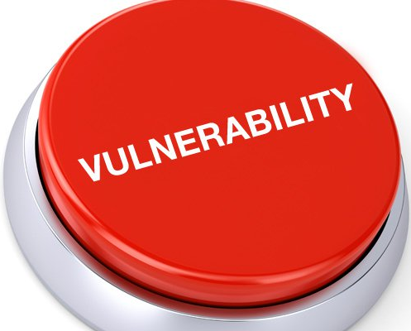
Vulnerability describes the characteristics and circumstances of a community, system or asset that make it susceptible to the damaging effects of a hazard. There are many aspects of vulnerability, arising from various physical, social, economic, and environmental factors.

Slide 5
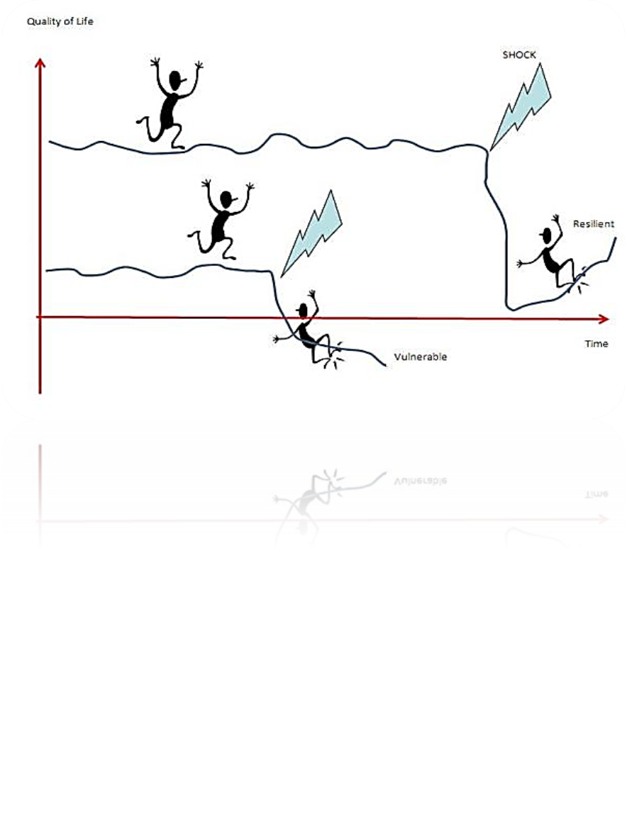
According to UNESCO/UNDRO (1982)
Vulnerability (V) is the degree of loss to a given element or set of elements at risk resulting from the occurrence of a hazardous phenomenon of a given magnitude. It is expressed on a scale from 0 (no damage) to 1 (total loss).

Slide 6
Types or Sectors of Vulnerability:
Vulnerability can be classified into two major types.
These are physical vulnerability and social vulnerability.
Further, the primary two groups are divided into subgroups,
like human vulnerability, agricultural vulnerability, infrastructural vulnerability, environmental vulnerability etc.
Physical Vulnerability:
Physical vulnerability implies the physical condition of people, and elements like buildings, infrastructure, etc. which may be damaged or destroyed by natural hazards such as floods, cyclones, and earthquakes etc. Vulnerability is not confined to physical sector only but also affects other segments related to human life and property. The main factor of physical vulnerability is geographic proximity to the origin of disaster.

Slide 7
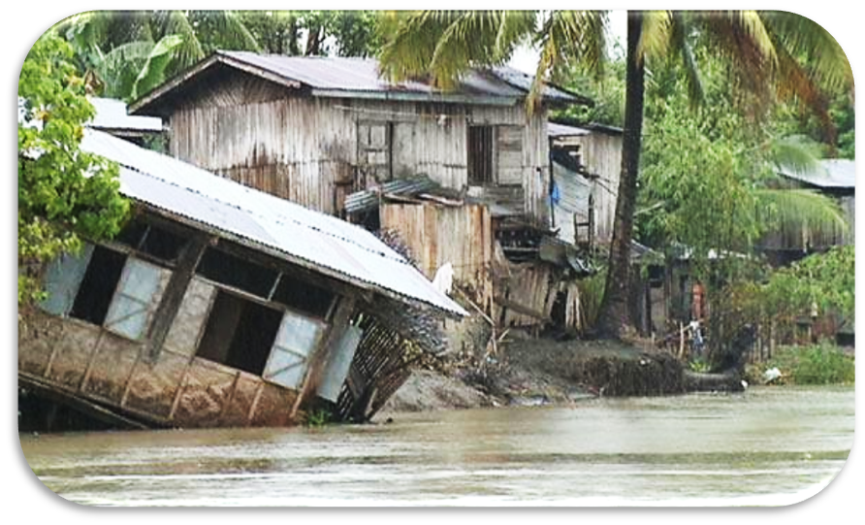
Example of Physical Vulnerability

Slide 8
Human Vulnerability:
Humans are the primary victims of natural hazards i.e., flood, cyclone, drought, earthquake etc. that can cause death, injury and illness. The level of exposure varies with the agents of hazard (water, wind, ionizing radiation and toxic chemicals) among affected populations. Based on exposure to hazards, some people may lose their lives, others may be severely or slightly injured and the rest of them may survive unscathed.
Agricultural Vulnerability:
After the human resources, the major affected sectors are agricultural plants and livestock by the extreme events. Like humans, they also have different natures and characteristics. Agricultural vulnerability is more complicated to assess as compared to human vulnerability due to the presence of a greater number of species among plant populations with different resistant capability to extreme events.

Slide 9
Infrastructural Vulnerability:
Structural vulnerability occurs when the materials and designs of constructed buildings are incapable of resisting extreme events (e.g., cyclone, flood, and earthquake) and are fragile to a hazardous situation. For example, the lower economic group people of the seacoast region do not have enough money to build sturdy concrete houses because of their poverty. As a result, they are living under the risk of losing their shelters during super and severe cyclones and are not able to reconstruct the houses.
Environmental Vulnerability:
A natural environment is no doubt the life support system for an entire living organism. A comprehensive approach to disaster reduction acknowledges that the environment plays an essential role in protecting its surroundings from the trigger of disasters. But, at the same time, it recognizes that the environment is itself vulnerable to disasters and post-disaster recovery due to loss of biodiversity and other ecological changes.

Slide 10
Social Vulnerability:
The concept of social vulnerability has been defined in terms of people’s ‘‘capacity to anticipate, cope with, resist and recover from the impacts of natural hazards’’ (Wisner et al. 2004). Social vulnerability is one dimension of vulnerability in multiple stressors and shocks, including abuse, social exclusion. It varies across the communities as well as within societies based on household status, which are consisting of psychological, demographic, economic, and political impacts.
Socio-Economic Vulnerability:
The degree of vulnerability can be defined not only by physical components but also by socio-economic conditions. Socio-economic vulnerability is measured by weak family structure, poor financial condition, lack of understanding for decision making, conflict, and discrimination based on caste, religion, ethnicity, and language, etc. In developing countries, social vulnerabilities exist to a large extent. The situation becomes more deteriorating when severe disasters (flood, cyclone, earthquake, etc.) occur and affect the poor socio-economic class of people of

Slide 11
any society or community.
Similarly, based on age and gender, the children, women, and elder sections of the population are more vulnerable as compared to men during the disaster.
Poverty and Disaster Vulnerability:
Poverty and risk to disasters are complicatedly linked to each other. The economically poor section of society is major victim of disasters. Among the poor section people, some have marginal lands and some are landless. Due to the shortage of land, they have fewer employment opportunities and unable to construct technically sound or safe shelter for themselves. Poverty pushes poor people to migrate and live in physically more vulnerable and unsafe locations. The developing and underdeveloped countries are more vulnerable to natural hazards than developed countries due to unawareness, decision making power etc. The level of poverty reflects by their building structure, density of population, road network, and communication system.

Slide 12
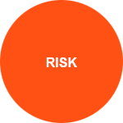
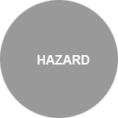
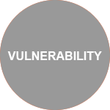
Disaster Risk
Disaster risk is expressed as the likelihood of loss of life, injury or destruction and damage from a disaster in a given period of time (UNDRR Global Assessment Report, 2015).
* *
Disaster risk is widely recognized as the consequence of the interaction between a hazard and the characteristics that make people and places vulnerable and exposed.
=

Slide 13
Disaster risk has many characteristics: In order to understand disaster risk, it is essential to understand that it is:
Forward looking :the likelihood of loss of life, destruction and damage in a given period of time.
Dynamic: it can increase or decrease according to our ability to reduce vulnerability
Invisible: it is comprised of not only the threat of high-impact events, but also the frequent, low-impact events that are often hidden
Unevenly distributed around the earth: hazards affect different areas, but the pattern of disaster risk reflects the social construction of exposure and vulnerability in different countries
Emergent and complex: many processes, including climate change and globalized economic development, are creating new, interconnected risks

Slide 14
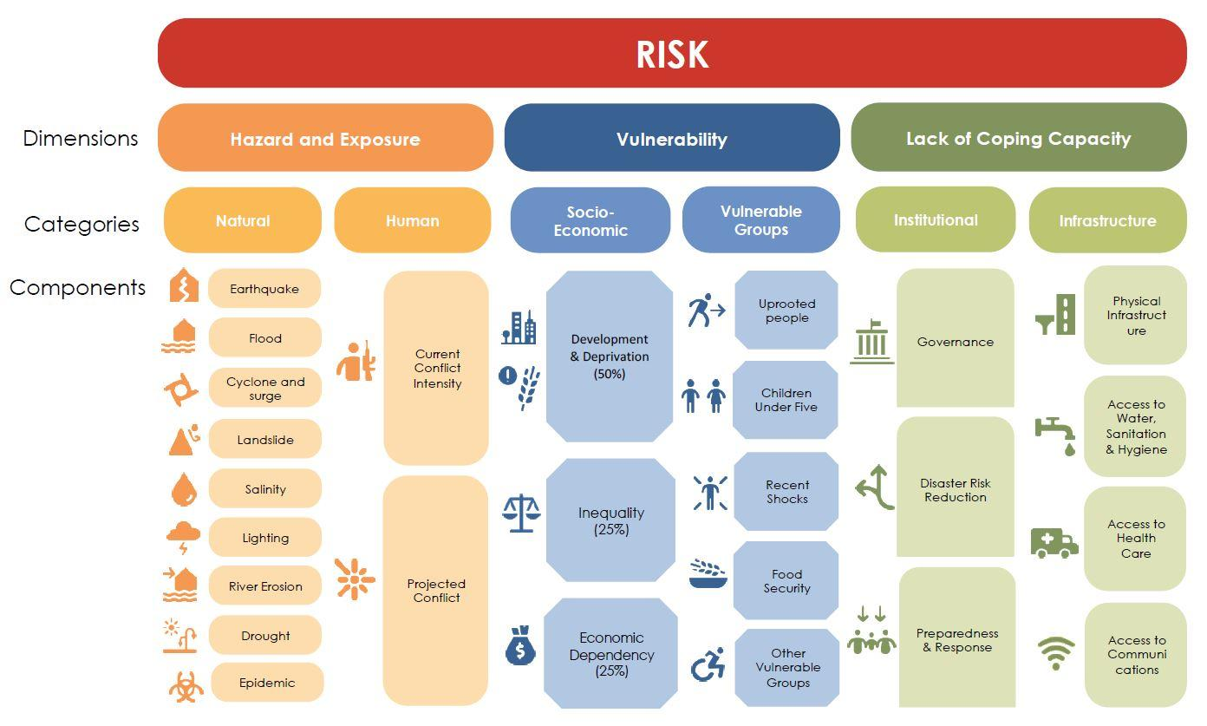
Illustration: Risk dimensions, categories and components retrieved from Bangladesh INFORM Sub-National Risk Index 2022, UNDRR (2022)

Slide 15
Why does disaster risk matter?
If current global patterns of increasing exposure, high levels of inequality, rapid urban development and environment degradation grow, then disaster risk may increase to dangerous levels.
If current trends continue, the number of disasters per year may increase from around 400 in 2015 to 560 per year 2030.
The average annual direct economic loss from disasters has more than doubled over the past three decades, showing an increase of approximately 145% from an average of around $70 billion in the 1990s to just over $170 billion in the 2010s.
Source: UNDRR, 2022

Slide 16
How do we measure disaster risk?
Identifying, assessing and understanding disaster risk is critical to reducing it.
We can measure disaster risk by analysing trends of, for instance, previous disaster losses.
These trends can help us to gauge whether disaster risk reduction is being effective.
We can also estimate future losses by conducting a risk assessment.
A comprehensive risk assessment considers the full range of potential disaster events and their underlying drivers and uncertainties. It can start with the analysis of historical events as well as incorporating forward-looking perspectives, integrating the anticipated impacts of phenomena that are altering historical trends, such as climate change.
In addition, risk assessment may consider projections of future hazards based on scientific knowledge, information and interdisciplinary findings, along with wide range of disciplines by expertise .

Slide 17
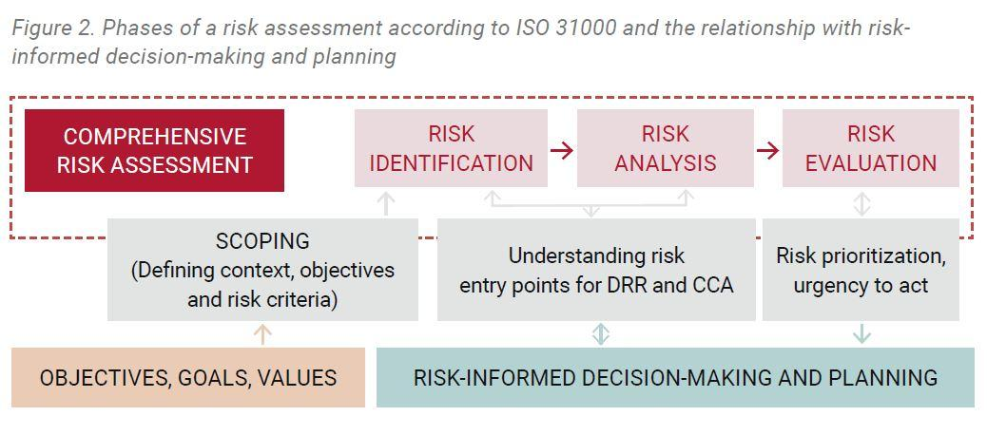

Slide 18
Ten key principles are proposed for a comprehensive approach for risk assessment and planning:
Putting risk to human and ecological systems at the centre;
Fully accounting for the context of climate change;
Recognizing the complex and systemic nature of risks;
Applying inclusive risk governance;
Using multidisciplinary approaches to identify and select measures;
Using the concept of risk tolerance;
Addressing, minimising and averting risks through Nature-based Solutions;
Integrating risk across sectors and levels;
Strengthening risk communication, information and knowledge sources;
Using iterative and flexible processes.

Slide 19
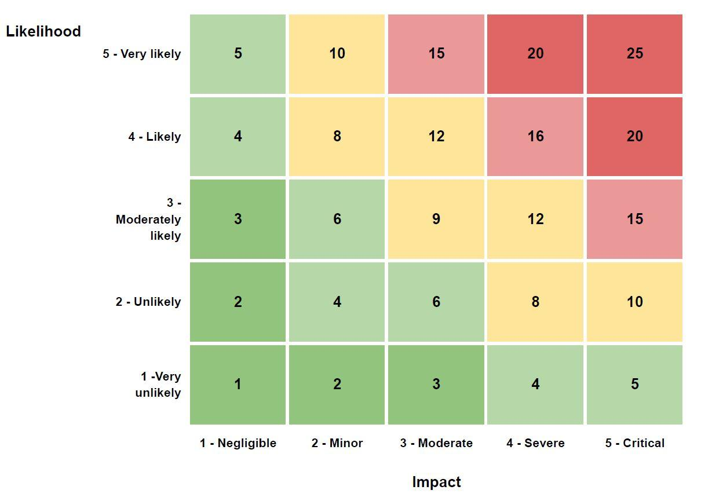

Slide 20
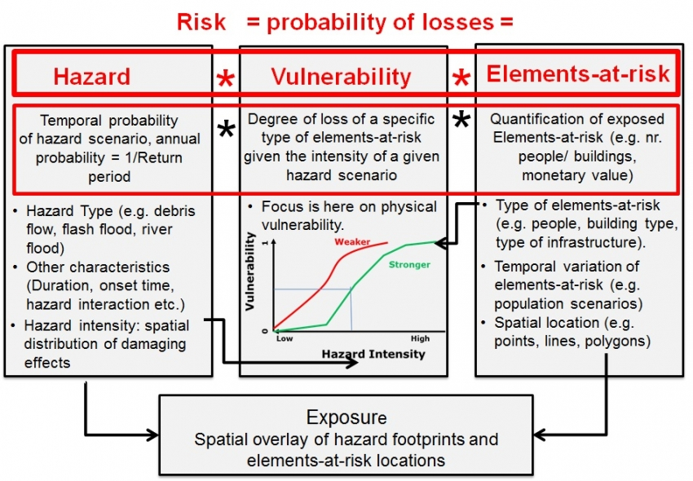
4. People's perception of Risk:
The process of finding out the perceptions of heterogeneous groups in the community regarding the disasters, hazards and risks that they are facing.

Slide 21
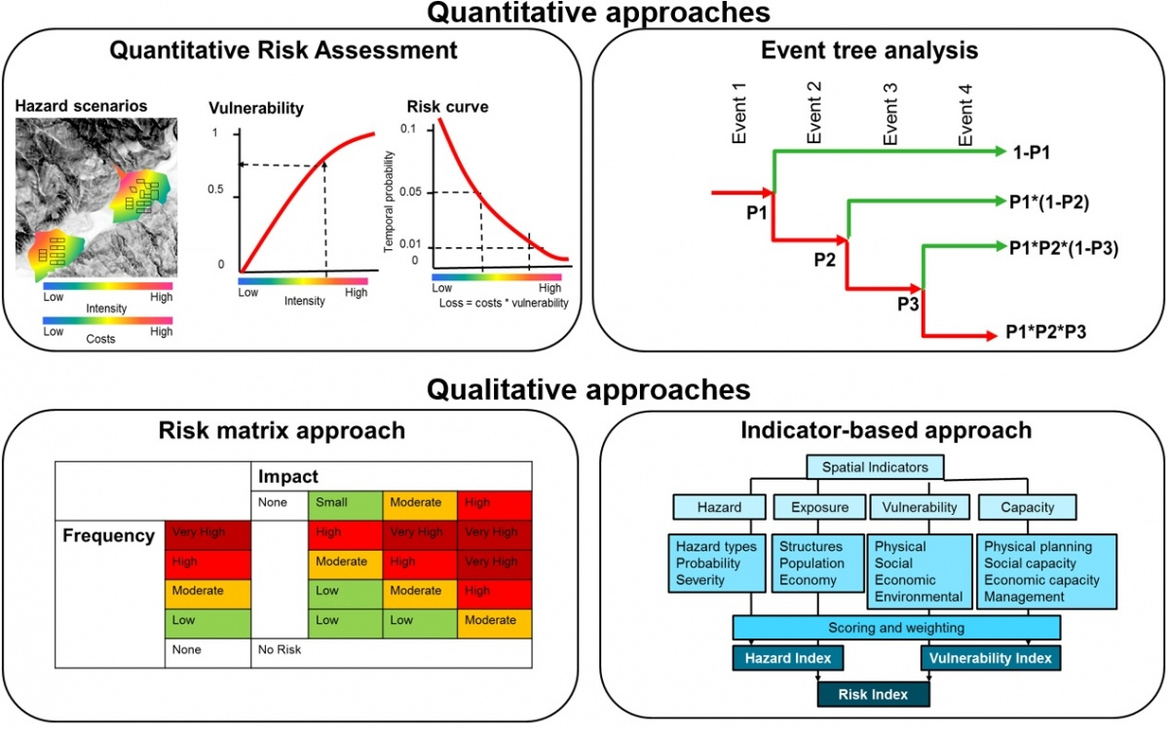

Slide 22
PRINCIPAL VULNERABLE ELEMENTS
HAZARDS | Tangible | Intangible
Floods | Everything located in flood plains or tsunami areas. Crops, livestock, machinery, equipment, infrastructure Weak buildings | Social cohesion, community structures cohesion, cultural artifacts
Earthquakes | Weak buildings and occupants. Machinery and their equipment, infrastructure. Livestock. Contents of weak buildings | Social cohesion, community structures cohesion, cultural artifacts
Landslides | Anything located on or at base of steep slopes or cliff tops, roads and infrastructure, buildings on shallow foundations | Social cohesion, community structures cohesion, cultural artifacts

Slide 23
Strong winds | Lightweight buildings and roofs. Fences, trees, signs; fishing boats and coastal industries, Crops and livestock. | Community structures, social cohesion, cultural artifacts
Technological disasters Chemical / Hazardous Materials (HAZMAT) Emergencies. Dam Failure. Nuclear / Radiological Event. Power Outages. Cyber Security. | Lives and health of those involved or near the vicinity. Building, equipment, infrastructure, crops and livestock Destruction of the environment. | Cultural losses. Possible population disruption.

Slide 24
Ways To Cope With Natural Disasters
Though the effects of natural disasters can be severe and far-reaching, there are steps any one can take to cope. Here are some ways you may be able to reduce the trauma of a natural disaster.
Seek out and connect with social support:
Research has consistently found that early intervention, resources, and support from others can be a major factor in helping people overcome the negative effects of a traumatic event. Given that a natural disaster can impact an entire community, your support system may be weakened by a natural disaster. However, even connecting with one person can make a difference.
Identify local support groups or available crisis counsellors to talk to:
After a natural disaster, crisis counsellors may be brought in to offer support and help you come up with ways of coping with the impact of a natural disaster. Take advantage of these opportunities.
﻿

Slide 25
Practice healthy coping strategies:
A natural disaster can trigger any one with intense negative experience and emotions. Therefore, it is very important to identify healthy ways of managing these emotions. Alcohol or substance use, excessive sleep, and unhealthy food can be effective short-term strategies for managing emotional distress, but in the long-term, these behaviours don't address the root issue and often increase distress.
Try to limit other sources of stress in your life:
Although you may have little control over other sources of stress in your life, try to limit the extent to which you make major decisions or life changes. Your most important task following a natural disaster is getting your life and emotions back in order. Therefore, it is important to put yourself in a place where it is going to be easier to do this.
Find ways to help others:
Helping others can provide you with a sense of agency, purpose, control, and empowerment.

Slide 26
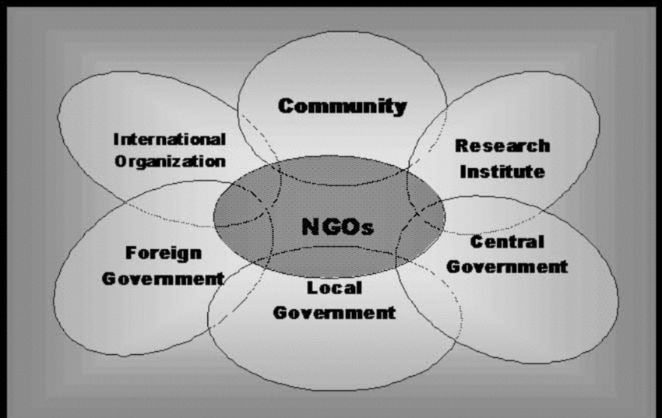
Disaster Management Committees and Teams, Disaster Management Plans, Mock Drills, Vulnerability Assessments, and Collaboration with Government and Non-Governmental Organizations, they play an important role in the immediate aftermath of disasters by assisting with rescue and first aid, sanitation and hygiene, damage assessment, and help to external organisations bringing relief supplies.

Slide 27
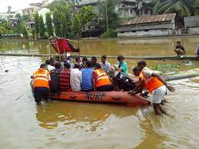

Slide 28
WARNING SYSTEM IN DISASTER MANAGEMENT
Early warning systems have been around for a long time.
Ancient tribes in the Pacific observed the precursory signs of tsunamis in the ocean to warn their communities.
In a similar fashion, tribes in Africa and in the Americas watched the skies to warn about potentially catastrophic weather.
In the recent past, an improved understanding of the natural hazards that trigger disasters and the deployment of improved sensors and means of communication to transmit the data to observatories in countries have allowed for the improvement of early warning systems and to extend the list of hazards under surveillance.
Early warning systems are a major component of disaster risk reduction. They prevent loss of life, as well as reducing the economic impact of natural hazards. Increasing the availability of multi-hazard early warning systems and disaster risk information is one of seven global targets set by The Sendai Framework for Disaster Risk Reduction 2015-2030.

Slide 29
COMMUNITY PARTICIPATION & PUBLIC AWARENESS
Community participation, generally, refers to the involvement of people in any project to solve their own problems or to develop their socio-economic conditions. They participate in setting goals, and preparing, implementing and evaluating plans and programs.
Basically it is a dynamic group process in which all members of a group contribute, share or are influenced by the inter change of ideas and activities towards problem solving and decision making.
Public awareness: The extent of common knowledge about disaster risks, the. factors that lead to disasters and the actions that can be taken, individually and. collectively, to reduce exposure and vulnerability to hazards.
Why is awareness important in disaster management in the community?
Public awareness and public education for disaster reduction seek to turn available human knowledge into specific local action to reduce disaster risks. It mobilizes people through clear messages, supported with detailed information.

Slide 30
Community Participation activities before Disaster:
Focus group discussion
Awareness and conscious build up
Collect information and distribution
Mapping the vulnerable zone
Risk Assessment
Early warning by indigenous knowledge.

Slide 31
THANK YOU!

