Slide 1
SAPTAMATRIKAS OR THE SEVEN MOTHER IMAGES IN TEMPLE ART OF ODISHA: WITH SPECIAL REFERENCE TO COASTAL ODISHA
Dr Sushanta Kumar Patra
&
Sri Lalatendu Mallick
P.G. Dept. of AIHC & Archaeology, Utkal University, Bhubaneswar-751004, Odisha, (India)

Slide 2
Introduction
Matrika means Mother Goddess. “The conception of God as Mother is natural and ultimate. In almost all the ancient civilizations God is conceived as Mother. She is Prakriti, Earth and Mother Supreme” (Rajeshwari, 1989). The mother was regarded as the supreme creative principle, and perhaps, this belief was responsible for the emergence of the Shakti Cult. All (goddesses are worshipped and respected as the Mothers. The Cult of Mother Goddess existed even before the time of the Vedas it is the giver of Fertility and fortune both. In two ways, these goddesses are associated' with their respective male principles, such as Consort form and Shakti form. These two aspects of the female counterpart of the Gods are treated differently in the Sastras. The Shakti aspects of the female counterpart of the Gods are known as Matrikas. The Rig-Veda referred to the concept of seven divine Mothers or Saptamatrika. Usually, the Matrikas are seven in number, though eight or more of them can be counted. It appears that side by side with the common concept about the stereotyped number of the Matrikas or Shaktis of seven or eight Gods, there existed a belief about the Shaktis of other Gods or their aspects.

Slide 3
The term Saptamatrika is derived from two words Sapta and Matrika mean Seven Mother Goddess or Mother like goddess respectively. They are Brahmani (Sarasvati), Maheswari (Raudri), Kaumari (Kartikeyani), Vaishnavi (Lakshmi), Varahi, Indrani (Mahendri) and Chamunda (Chamundi). However, sometimes, Narasimhi is substituted Chamunda. Saptamatrikas are usually grouped together with Ganesa and Virabhadra. The number and names of the Matrikas increasingly standardized in the Post-Vedic period. During this, period Matrikas seem to have been brahmananised and domesticated moreover, the Saptamatrikas are referred to as seven saktis of the goddess who was originally created by the endowed energies of gods Brahma, Maheswara, Kumara, Vishnu, Varaha, Indra and Yama and they are armed with the same weapons, wear same ornaments and ride on the same vahanas of the corresponding male gods.

Slide 4
Monument of Odisha reflects material as well as spiritual aspects of our society. The evolution of human mind and elopement of spiritual thought through centuries can be studied by interpreting various aspects our culture. Our culture has been enriched by several religious belief and faiths which is flourished simultaneously. Rather the people of Odisha enjoyed religious toleration under the patronage of their rulers. Among all these religious sects, Saktism had been a strong force in Odishan culture. As elsewhere in India, the worship of female principle in the form of a Devine Mother appears very early in Odisha. Sakta cults have played a major role in the religious and cultural life of the people. Among the different manifestations of Sakta cult, Saptamatrika is an important and popular one. There are numerous centers of worship of Saptamatrikas spread in different parts of our country. But this cult is more widespread in Odisha and a very large number of panels and figures of Saptamitrikas are found in the temples all over Odisha. The innumerable number of Saptamatrika panels and images found in the temples of Coastal Odisha revel that the cult of Saptamitrikas was very popular in Odisha in the early medieval and medieval periods.

Slide 5
The Cult of Devine Mothers popularly Saptmatrikas influenced in the socio-cultural life of Odisha from the Bhumakara period to ensuing Ganga period, on the other hand, there are few surviving examples of Matrika sets, though there are scattered images of individual Matrika, such as Chamunda or Varahi, which generally serves as presiding deities and their matrika aspect is not stressed. When aligned in a set there are generally seven matrikas (Saptamarikas), occasionally eight, and they are invariably accompanied by Virabhadra and Ganesha. The Saptamatrika cult also received different royal patronage in different periods of Odishan history.

Slide 6
Saptamatrikas in Literature
Details regarding the worship and iconography of the Saptamatrikas are to be found in a wide range of devotional literature which may be classified into the following categories:
I. Puranas
II. Agamas
III. Samhitas and
IV. Tantras
The story goes that: “The demon Andhakasura who came to rule over the Asuras after Prahlada practiced many assurities, obtained boons from Brahma, and became very powerful. He caused annoyance to Devas; they ran to Kailasa to complain Siva about the troubles caused by the Asura chief. Siva was listening to the complaints of Devas. At the same time, Andhakasura appeared in Kailasa with a view to carrying away Parvati. Siva thereupon got ready to fight the Asura; he made three well-known snakes Vasuki, Dhananjaya, Takshaka serve as his belts and bracelets. An Asura called Nila, who had secretly planned to kill Siva in the form of an elephant. Nandi came to know this and informed Virabhadra and took the form of the lion and attacked and killed Nila. Virabhadra presented the skin of this elephant to Siva, which was worn by him as his upper garment. Clad with this curious garment and ornamented with serpents, and wielding his powerful Trisula against Siva treated out on his expedition against Andhakasura. He took with him his army consisting of the Ganas. Vishnu and other gods went along him to help. In the struggle that ensured Vishnu and other devas fled. At last, Siva attacked the asura with an arrow and wounded him. Blood began to flow in profusion from the wound and each drop of blood as it touched the earth assumed the shape of another Andhakasura. Thus there arose thousands of Andhakasura and began to dance. Vishnu destroyed the secondary asuras produced from the blood drops with his chakrayudha. To stop the further multiplication of asuras, Siva created out of the flame that issuing from his mouth a Sakti called Yogeswari. Indra and other gods also sent their Saktis to serve the same purpose. The Saktis thus created were Brahmi, Maheswari, Kumari, Vaishnavi, Varahi, Indrani, and Chamunda.” (Rao, 1914).

Slide 7
In Varahapurana the Devi, Vaishnavi in an account of the creation of the Matrika, is doing asceticism on Mount Mandara. At one point she loses her concentration. From her disgraced mind, several beautiful attendants were created. They later became Devi’s helpmates on the battlefield when she fights the demon. Although the Matrikas are described as lovely in this account, it is important to note that they are born when Devi losses control of her concentration. This suggests that the matrikas are essential of uncontrolled natures. Born from lack of mental control, they lack control themselves. Varaha Purana relates them to vices or inauspicious emotions; Brahmi of Mada, Maheswari of Krodha, Kumari of Moha, Vaishnavi of Lobha, Indrani of Matsarya, Varahi of Asuya and Chamunda of Paisunya.

Slide 9
Previous Wark
Saptamatrika is an important cult all over India in Hindu pantheon but did not received adequate attention for its study related with Buddhism, especially the lower strata of society who worshiped as a main deity. The previous scholar are not given attention on the relevance of iconographical features in various period, its stylistic development, not even identify proper icons, how this one placed in the Hindu sect as an unexplored area. Scholars have thrown light on the concept of Saptamatrika images but no comprehensive study has been made so far. K. S. Behera and Thomas, E. Donaldson’s Sculpture Master Pieces of Orissa, Aryan Book International, New Delhi, 1998 while giving an account of the style and Iconography and does not paid adequate attention to the ritual scenes prevailing in Odisha.
J. Dora, Saktamanuments of Orissa, New Delhi, 2010, is a documented work on the Odishan Saktisim, however She has mainly concentrated on Historical context only and does not account for other Saptamatrika shrines and their artistic or architectural significance.

Slide 10
Sculptural Representation of Saptamatrikas
Prevalence the earliest sculptural representation of Saptamatrikas occurred in the Harappa or Indus Valley civilization flourished. A seal discovered from Mohenjo-Daro in the Indus period has the representation of seven figures standing (almost dancing pose) beside a tree (Parpola, 2001.261). Representations of matrika figures with definite characters are from Kusana period onwards. A large number of matrika figures in both stone and terracotta are found during this period. From the Gupta period onwards, the Saptamatrikas were often carved in relief on a rectangular slab with the figures of Virabhadra and Ganesa flanking them. The earliest epigraphic reference to the Matrakas is to be found in the Gangadhara stone inscription of Vishwa Varman, in Malwa Samvat 480 or 423-424 CE. The Matrakas also figure in the Vihar Stambha Inscription of Skanda gupta. Kadambari mentions that the Matrakas were worshipped in every village. In the medieval period, the divine mothers are carved either together in a group or independently as one or two deities on a pedestal. The number of matrikas also varies from three, seven, eight or sixteen in various texts. Matrikas were the tutelary deities of the Chalukyas and Kadambas. The copper plates of the early Chalukyas of Badami referred to them as the seven mothers. Many of the inscriptions of the 10th-11th centuries CE record grants for the worship of parivara deities including Saptamatrikas. An inscription from Alambakkam dated in the Thirty one year of Chola Rajadhirajadeva (1049-50century CE.) mentions endowment to the temple of Saptamatrikas for the conduct of their worship (Srivastava, 1978.86). The iconic representations of the matrikas have occurred in Odisha from 7th century CE onwards.

Slide 11
Saptamatrika Panels and Images in Coastal Odisha
We have numerous Saptamatrika panels and loose stone images in the temples and museums attesting the prevalence of the cult of Saptamatrikas in Odisha. The Saptamatrika panels and images in the temples withstanding the ravages of time till speak of the past glory of the Saptamatrika cult. The survey of Saptamatrika panels and images in the temples and museums of Odisha shows that the matrikas are represented either in group or separately with two, four and eight arms, with vahanas and associate deities Virabhadra and Ganesa and without them and with local and chronological divergences They serve as the data for the study of the evolution of the iconographical features of the Saptamatrikas in the temple art of Odisha in general Coastal Odisha in Particular.

Slide 12
The earliest extant set of Saptamatrikas appears on the north wall of the jagamohana of the Parasuramesvara Temple. The matrikas are seated in padmasana or paryanka rather than in lalitasana as standard on later images. In the sanctum of the Vaital Deul there are eight matrikas (astamatrikas), including the presiding Chamunda who is larger in size.

Slide 13
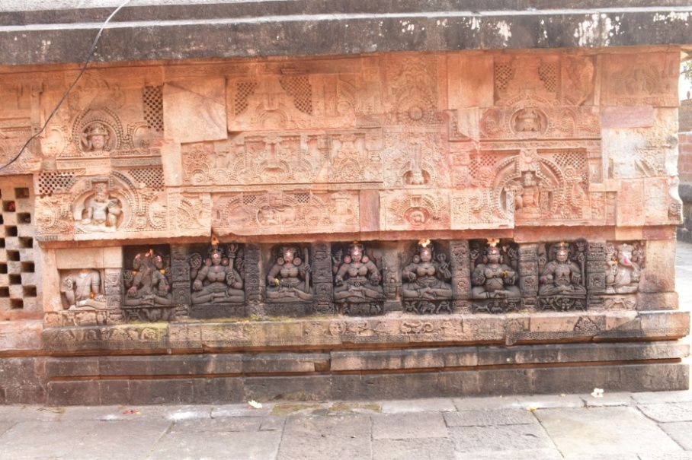
The earliest extant set of Saptamatrika images appears on the northern wall of the jagamohana of Parasuramesvara Temple at Bhubaneswar

Slide 14
One of the earliest sets of Saptamatrikas in eastern Odisha in which a child is supported on the thigh is the one on the jagamohana ceiling of the Muktesvara. They each occupy a petal, along with Virabhadra, in the lotus-medallion at the center. Except for Chamunda, childless and in ardhaparyanka, they are each in lalitasana and hold a child. In the Madalapanji it is recorded that Chakrakesarin, a king of the Kesari or Somavamsi dynasty, erected a temple of eight Chandis or matrikas and that another Somavamsi ruler, Bhimakesarin (Bhimaratha), who was a great worshipper of Devi, installed seven sisters (satabhauni) on the Eastern side of the Markandesvara tank. The seven sisters mentioned in the Madalapanji most likely refer to the matrikas which still exist on the eastern side of the markandesvara tank at Puri. There is also a set of matrikas carved on the upper jangha of the deula of the Jalesvara temple at Kalarahanga and another set on the upper jangha of the Brahmesvara temple at Beraboi, both temples dating to the end of the Somavamsi period.

Slide 15
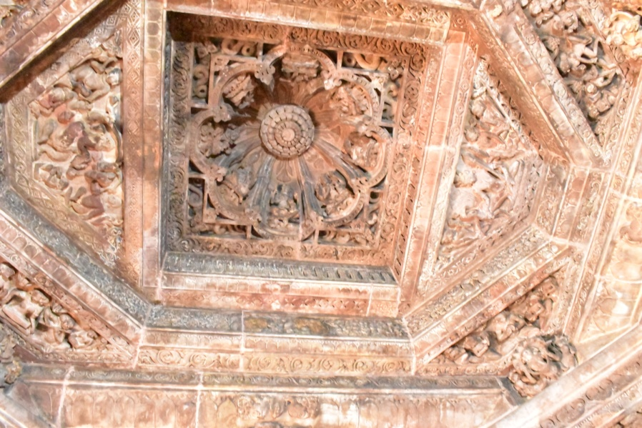
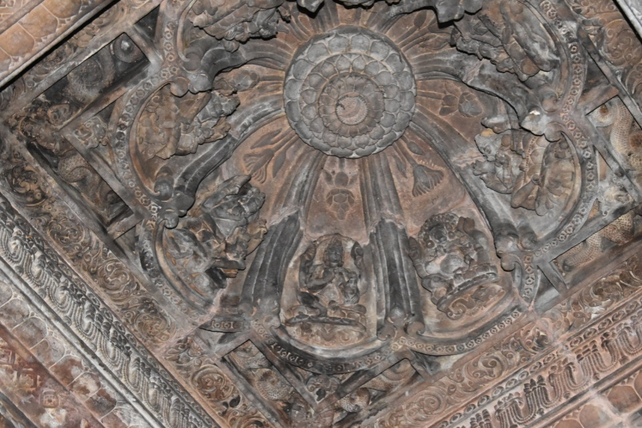
A sets of Saptamatrika images which a child is supported on the thigh on the jagamohana ceiling of the Muktesvara Temple at Bhubaneswar, Khurda

Slide 16
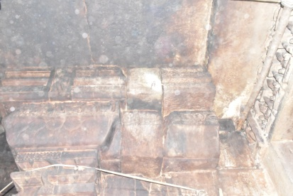
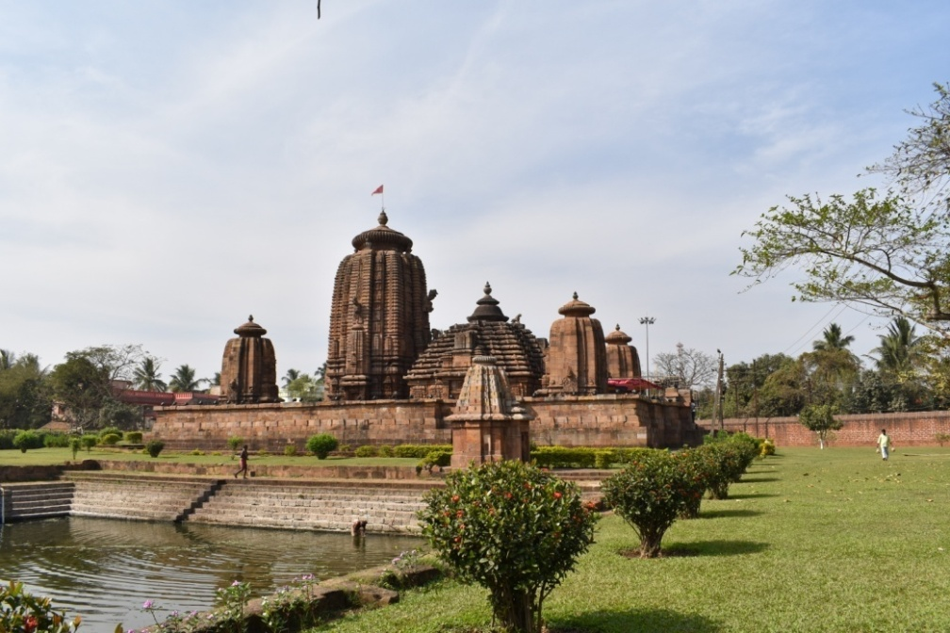
A sets of new discovered Saptamatrika images which a child supported on the thigh on the jagamohana ceiling of the Brahmeswara Temple at Bhubaneswar

Slide 17
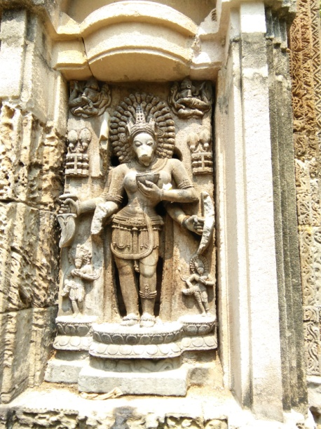
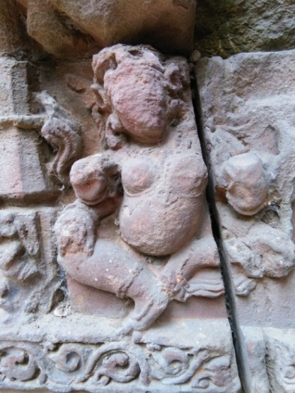
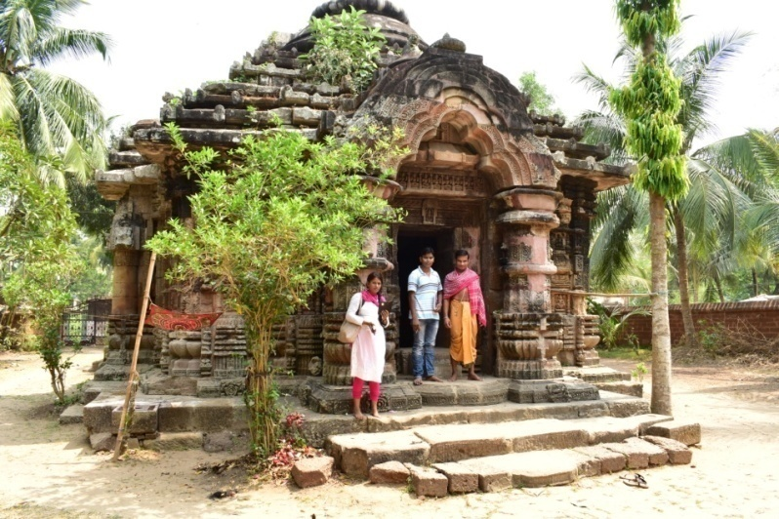
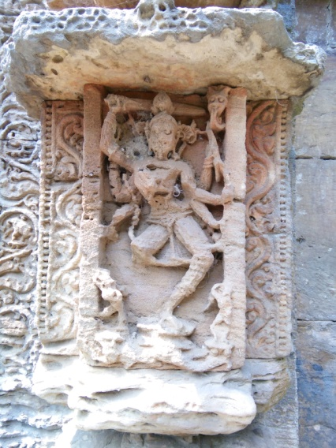
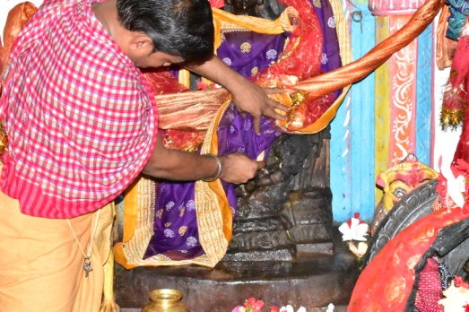
New discovered loose sculptures of Saptamatrika images of the bada portion on jagamohana of the Gangeswari Temple at Gop District puri

Slide 18
The only set of matrikas which can definitely be assigned to the Ganga period appears on a chlorite slab at Garudipanchana. The slab, now containing five matrikas, was possibly placed above the door frame of the jagamohana. At present the slab is laying on the floor of the jagamohana. The matrikas are each seated in lalitasana with a child on their left thigh and their right hand is in abhaya in a conventional manner.

Slide 19
Discussion
Mother goddess or Matrikas are the proto type of power (prakrit) which developed into that of Sakti in India, in her representation are the gramadevatis, who are the personifications of the same power in India as well as in Odishan society also, matrikas are the guardian of the house and village, presides over child birth and taking a more human interest in their needs is altogether closer to her worshippers than any of the recognized Hindu gods. It is no doubt that the state of Odisha has been blessed with the treasure of sculptural images related to mother goddess is rich with Saptamatrika. The Matrikas are idolized as carrying and protective mothers by the sculptures as against their frightening and ferocious depiction in the scriptures. In some places, the Goddess are each provided with a child each, which is placed on the lap. The sculptures radiate reverence, not horror, through the associated symbolism and attributes of each Matrikas are retained. This singular characteristic has been the mainstay of Saptamatrika images. This moderation of the ferocity of the Saptamatrikas, when transferred from scripture to an image is guided by the fact that art most look beautiful and hence something terrible is to be transformed into a liable figure. The only exception is the two Matrikas, Chamunda who is always present as ferocious even in art, and Varahi with boar’s face. The cult of Saptamatrikas and its related rituals have occupied a position in the art and iconographic history as well as in the socio-religious life of the people of Odisha.

Slide 20
Thank You

