Slide 1
Odishan Temple Architecture
Dr Sushanta Kumar Patra
Assistant Professor (Stage-III)
P. G. Department of A.I.H.C & Archaeology, Utkal University.

Slide 2
Concept of Temple Architecture
Vedic Period-The cult of sacrifices & the concept of fire alter arises
Hatigumpha inscription- refers devayatana
Amritesvara cave temple inscription- refers nagara, dravida & vesara along with Kalingan architecture
Silpa text- bhubana pradipa, silpa ratnakosha, silpa prakasha refers Odishan temple architecture

Slide 3
Odishan Temple Architecture
According to Silpa text Odishan Temples are of five categories……
Rekha deula,Pidha deula, Khakkara deula , Circular temple & Gaudiya temple.
Other names of the temples are Devayatana, Mandira, Prasada, Bhubanam, Vasa, Graha, Devakula, et. Cetera.

Slide 4
Rekha Deula
Rekha Deula- called badadeula, garvagriha, sanctum ,vimana.
Womb house for gods & goddesses
Interior is completely dark, where the cosmic being is placed
It looks circular due to large projections but its ground plan is square or rectangular.
Curvilinear spire Vertically divided into 4 divisions- pista, bada, gandi and mastaka.

Slide 5
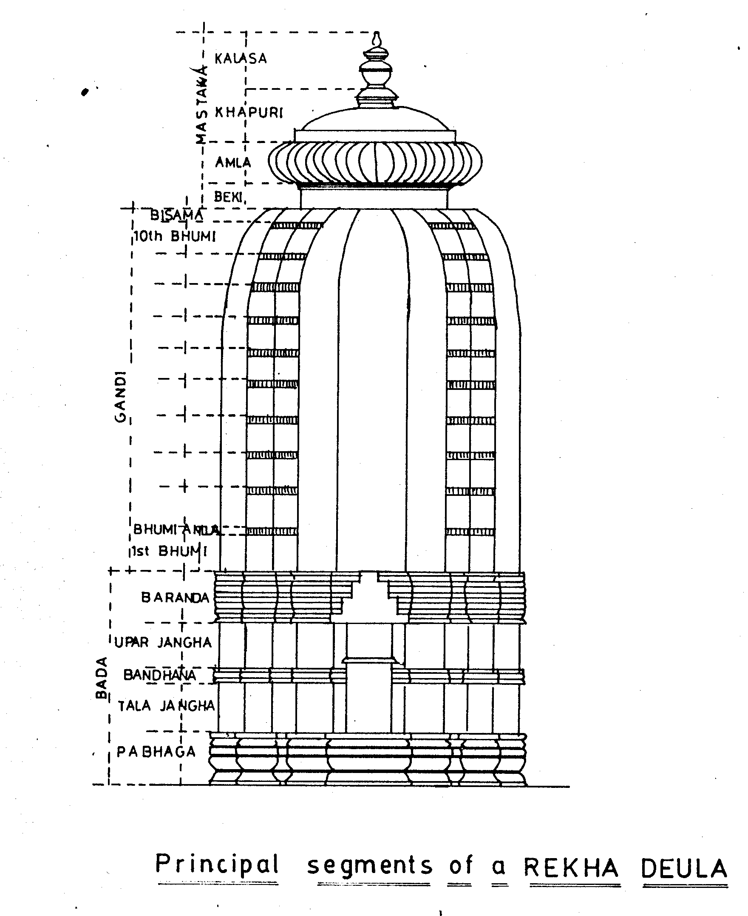

Slide 6
PLAN-2

Slide 7
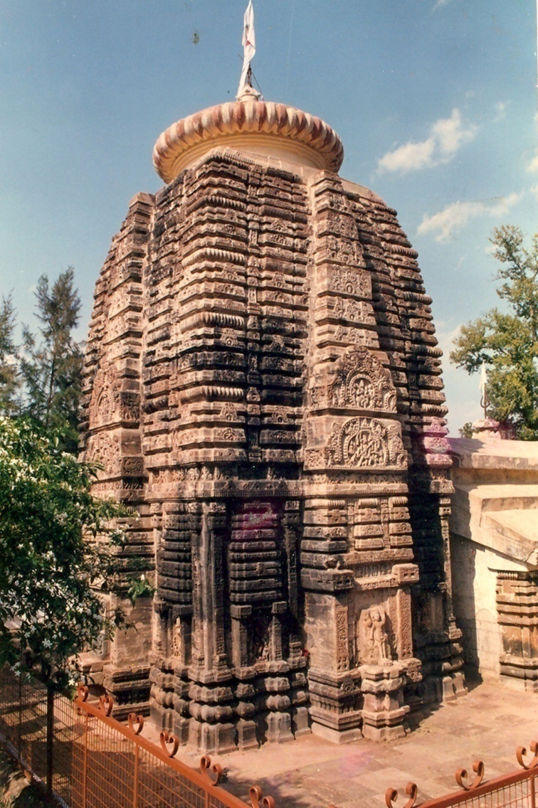

Slide 8
1. Pista: called pistha or platform it is not a regular feature in the earlier group but regular in Ganga period. In 13th century it became a raised platform called upana. 2. Pista :divided in to 3 to 5 divisions.

Slide 9
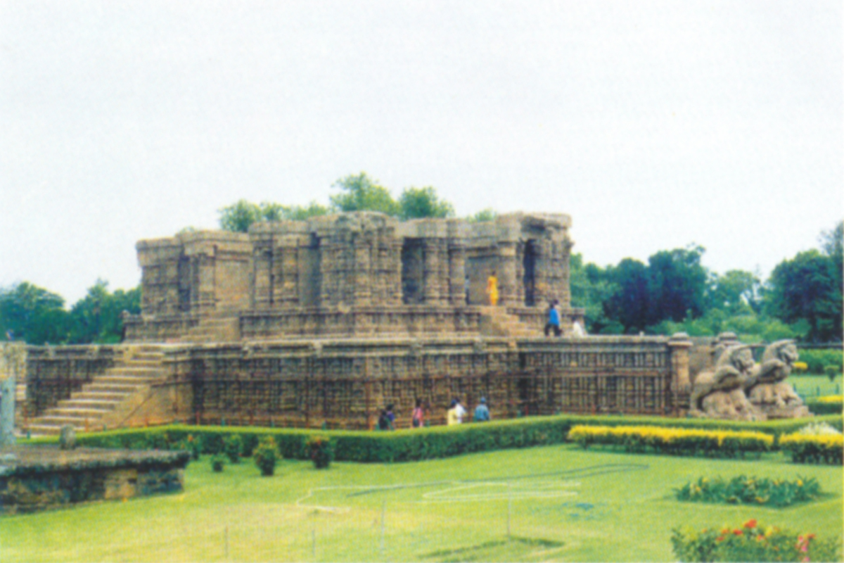

Slide 10
2.Bada:Is the perpendicular wall of the temple.
Earlier period- 3 division- pabhaga, jangha and varandha.
Later period-5 division- pabhaga,talajangha bandhana , upparajangha and varandha.
Pabhaga- Earlier period- 3 division- khura, kumbha and patta & Later period-5 division adition of kani and basanta.
Jangha-earlier is one and later in two division ie. talajangha and upparajangha.
Varandha-the upper most part of bada,it compose a series of mouldings ie. 5,7,9 et,cetera.
Bada have also vertical positions- trianga, panchanga and saptanga.

Slide 11
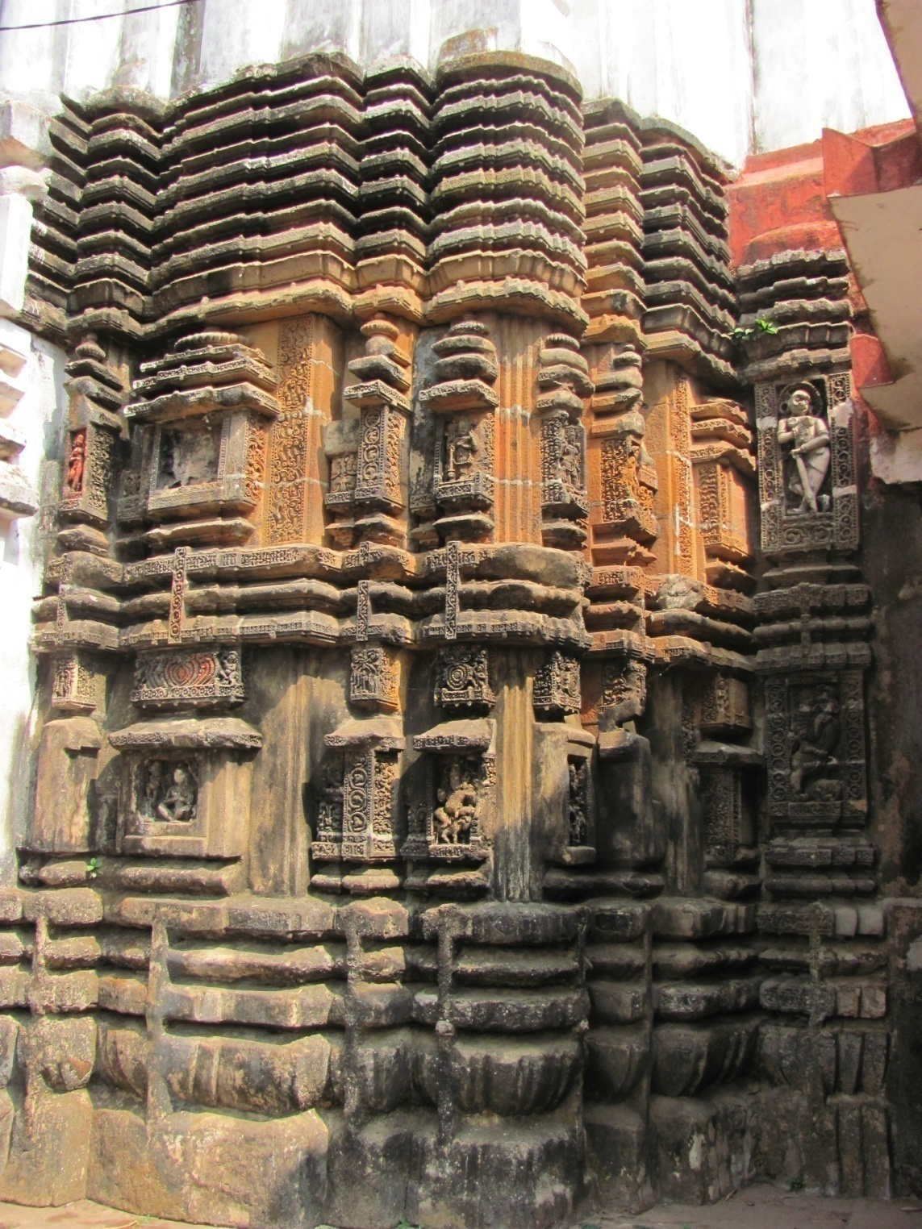

Slide 12
3. Gandi division : Central portion of the deula - called sikhara ( meaning towar)
Dividing line between bada and mastaka
Gandi of the rekha rises upto a certain height then curve inward.
Gandi has offset projections called- rathas or pagas ie. Raha paga, anuraha paga,anuratha paga ,pari ratha paga and kanika paga.
earlier gandi has triratha and later it becames 5,7 &9.

Slide 13
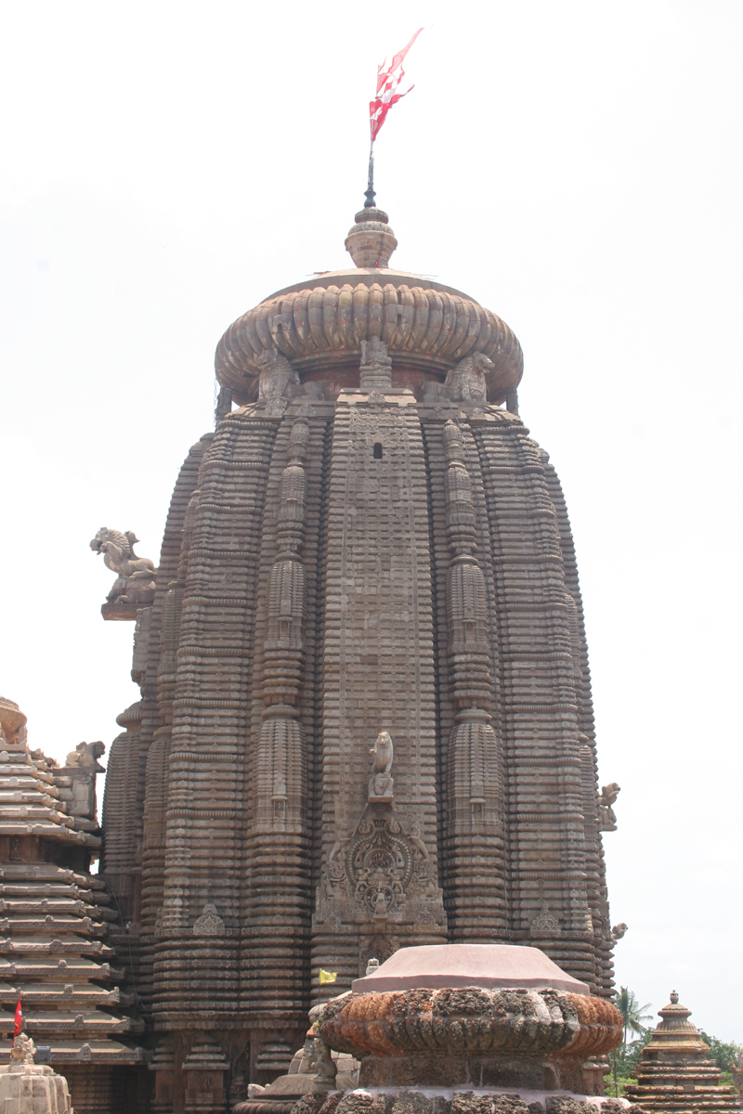

Slide 14
4. Mastaka Division: Upper most part of the Deula
The segments : beki , amala, khapuri, kalasa ,ayudha and dvaja.
Beki separates the square gandi from the mastaka.
Amala is the circular crown of the temple.
By covering the amala the structure is called khapuri.
On the above the crowning element is kalasa..
Top most part is the symbol called ayudha
Above that the dvaja or pataka

Slide 15
Pidha deula
Rekha deula has another temple in front ie. Pidha deula which has a Pyramidal super structure.
Other names are - mukhasala, mukhamandapa, bhadradeula, jagamohana et.cetera.
Meant for Prayer/ Hall of Audience.
Earlier there was no mukhasala, 7th & 8th cen. Flat roof arises , 9th cen.- One pidha there after potala added to pidhas
The pidhas were arranged in a receding order , lower one is the biggest and the upper one is the smallest.

Slide 16
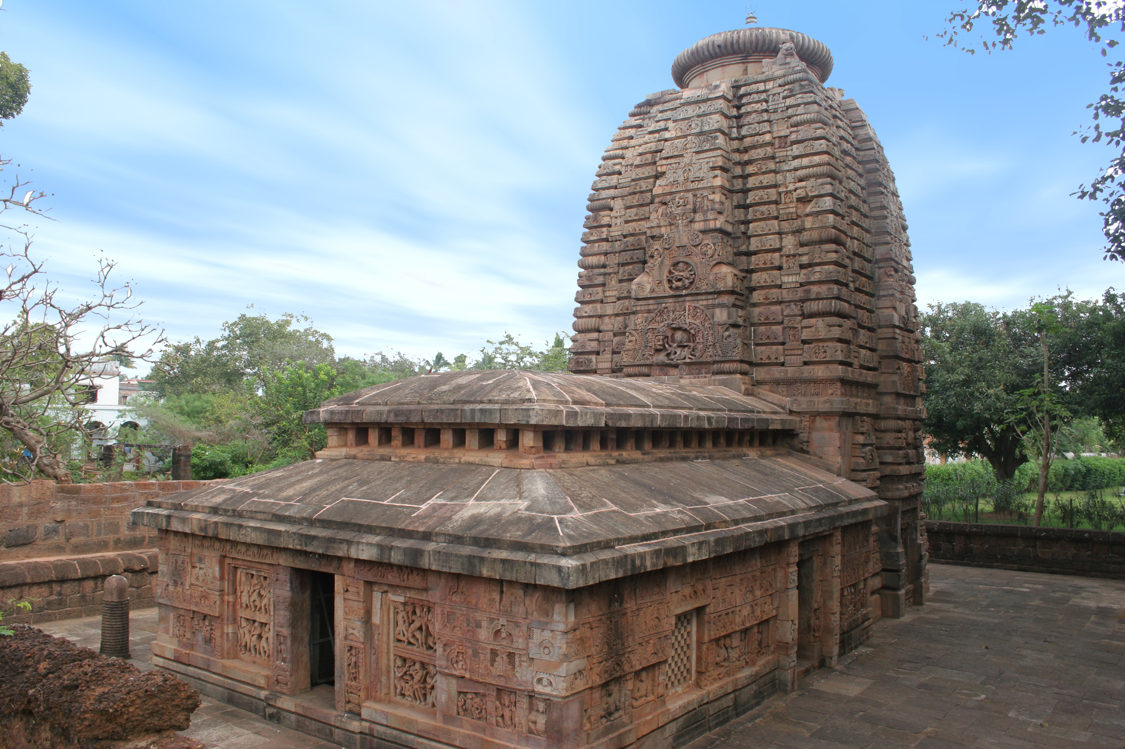

Slide 18
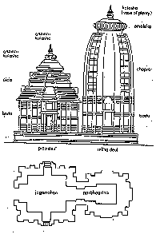

Slide 19
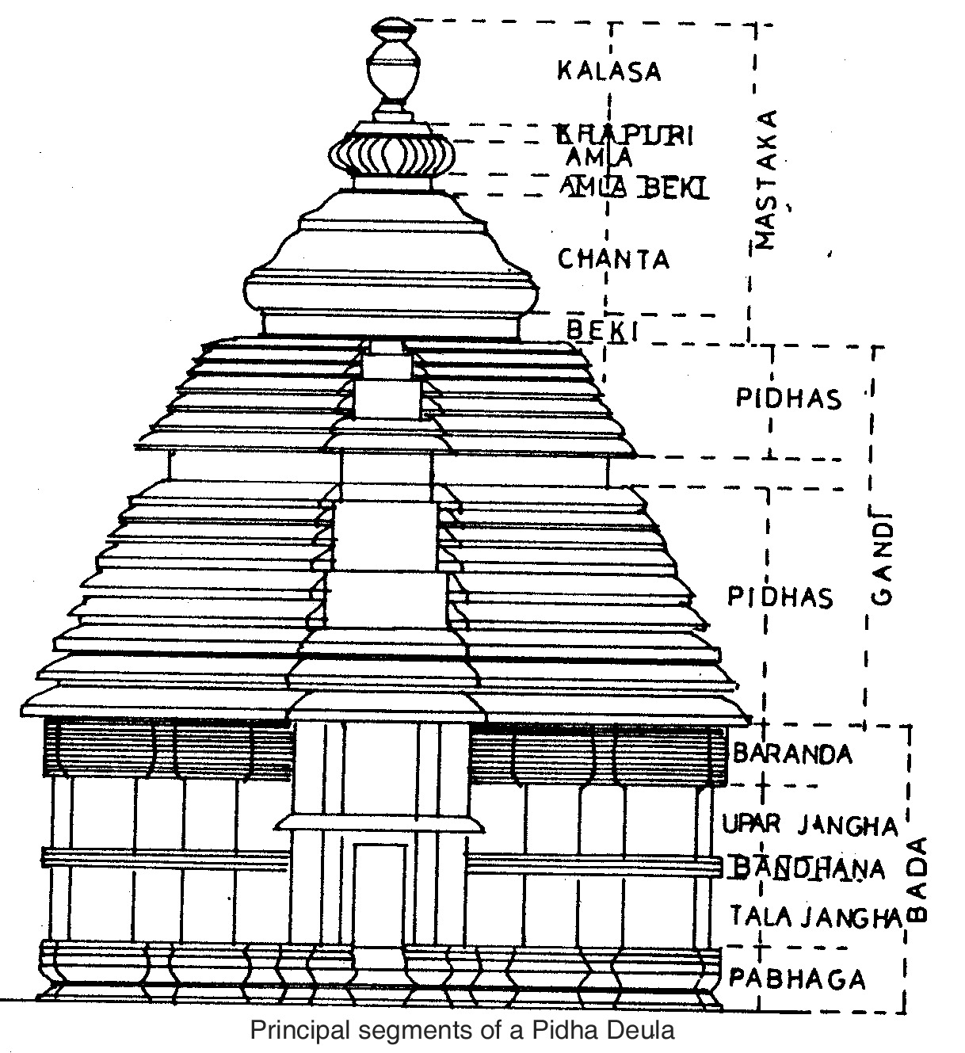

Slide 20
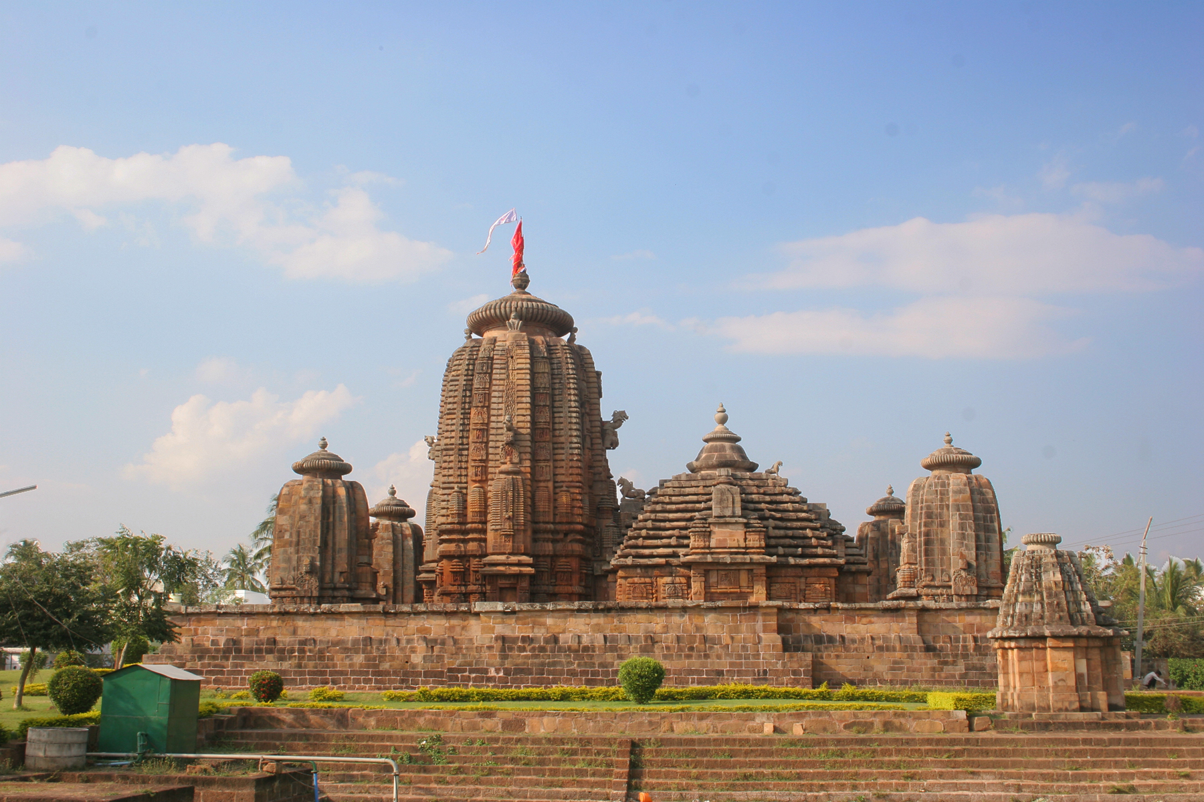

Slide 22
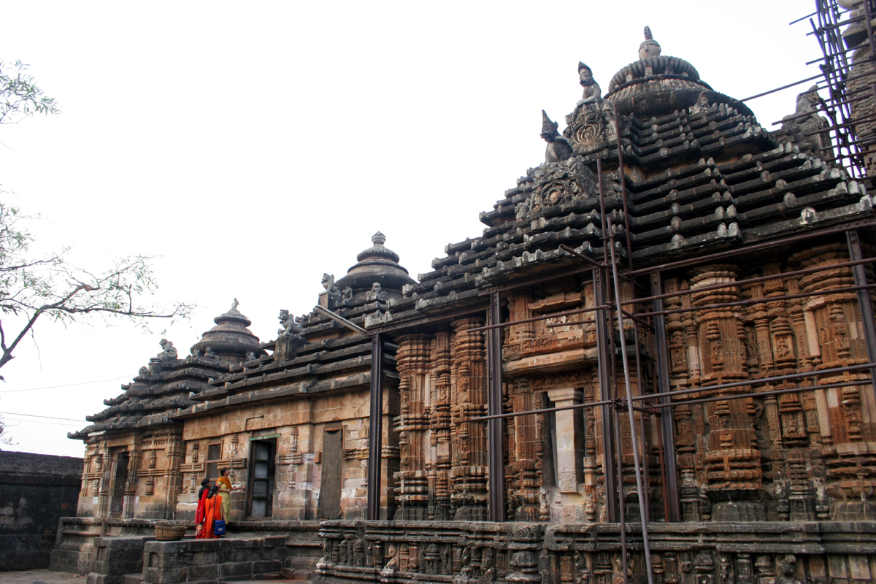
Pidha deula

Slide 23
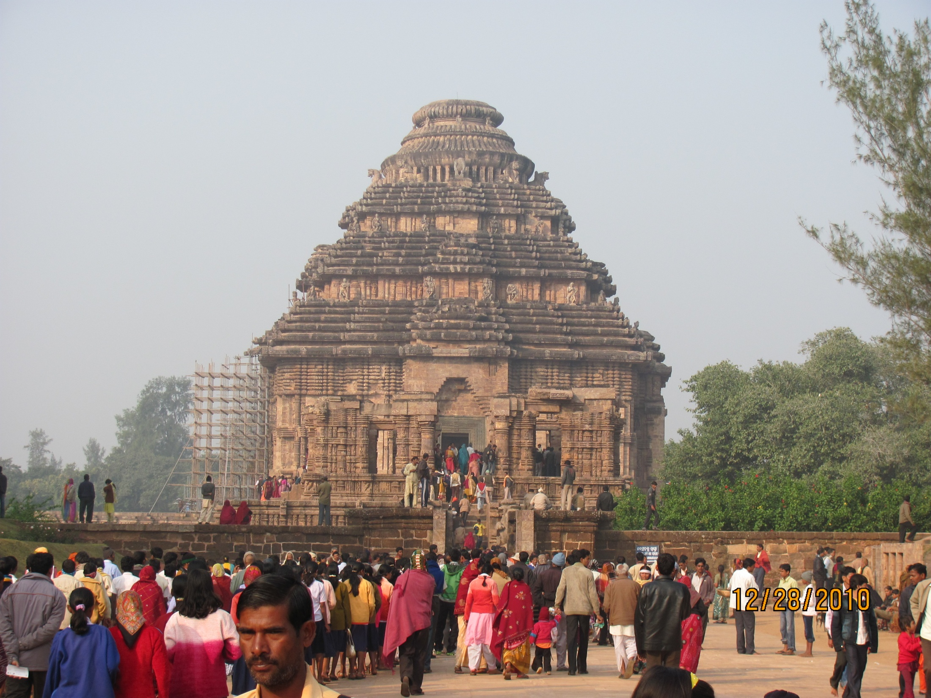

Slide 24
Khakkara Deula
Khakkara deula –meant for shakti worship.
It resembles with voita kakharu- local name of pumpkingouard.
Voita or boat like shape ie. Barrel vaulted roof.
According to K.C.Panigrahi –the name vaitala has been derived from vetalas or spirits, who were called upon by the kapalikas, at the time of worshiping Chamunda, the presiding deity.
M.M.Ganguly- traced its origin to the rock cut rathas at mahabalipuram.
Some says that it is distinguished by wagon –vaulted roof, which is derived from the buddhist chaitya hall.

Slide 25
3.9 Karli Cave, Early 2nd CE

Slide 26
Features of Khakkara Deula
Oblong in ground plan
Semi cylindrical vaulted roof
Replica of the rock cut rathas of the Pallavas.
The crowing elements -different than other tow types ie . Rekha and Pidha.
Most of the temples belongs to 8th century. A.D. Having flat roofed jagamohana in front.

Slide 27
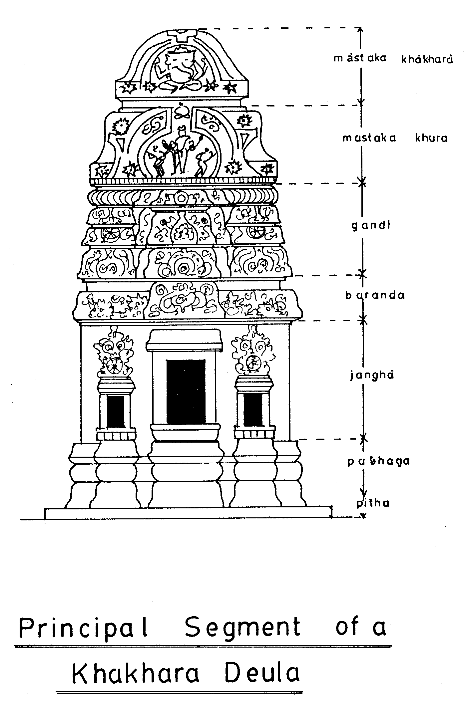

Slide 28
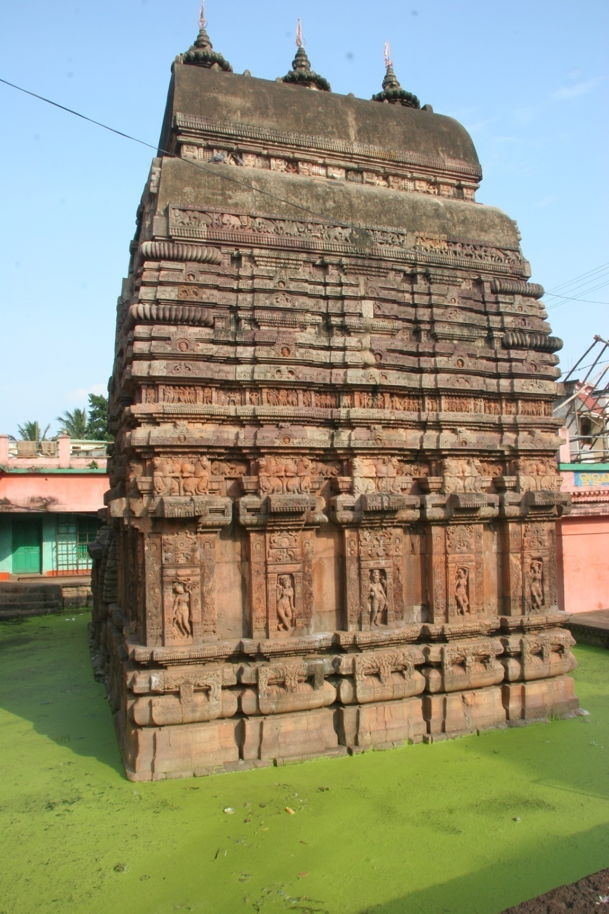

Slide 29
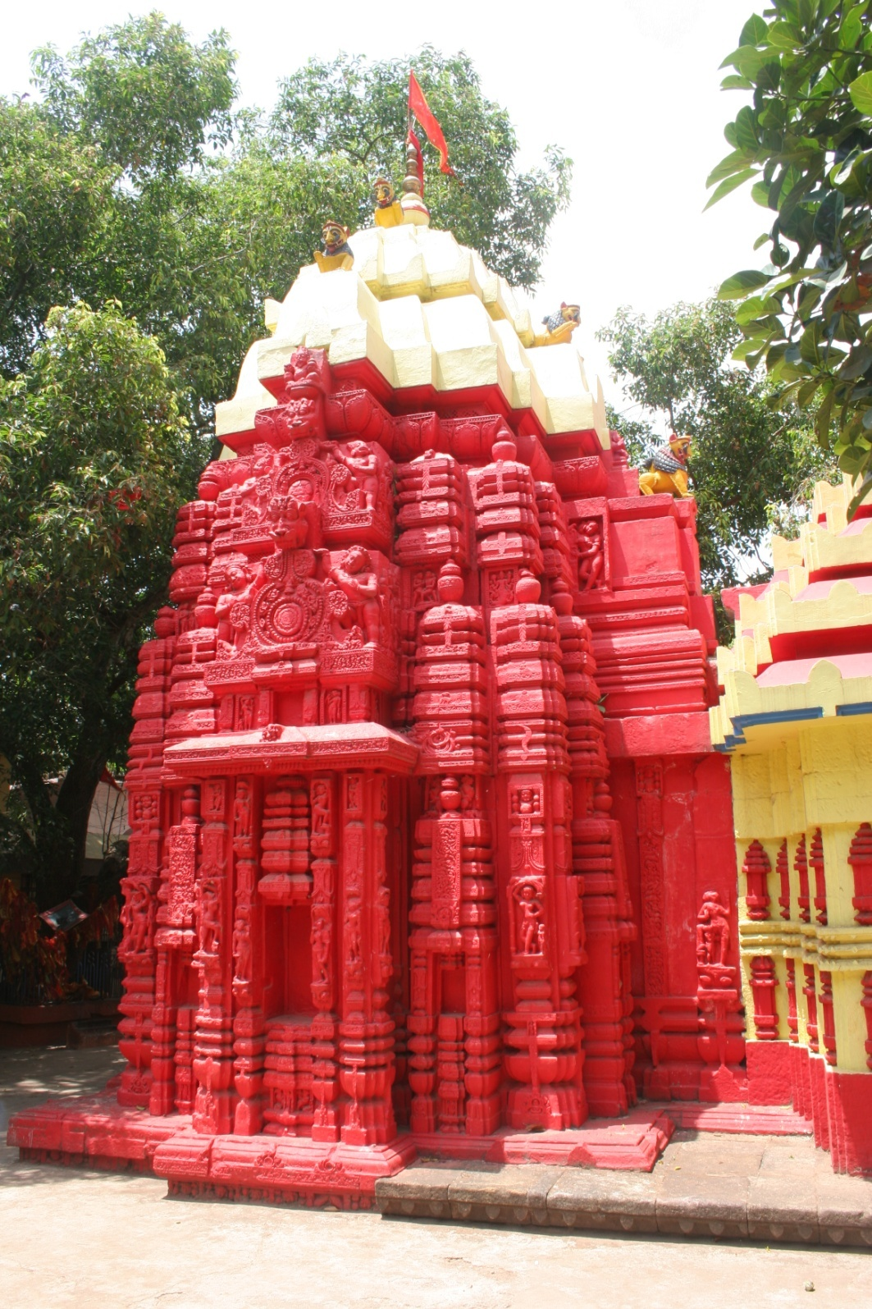

Slide 30
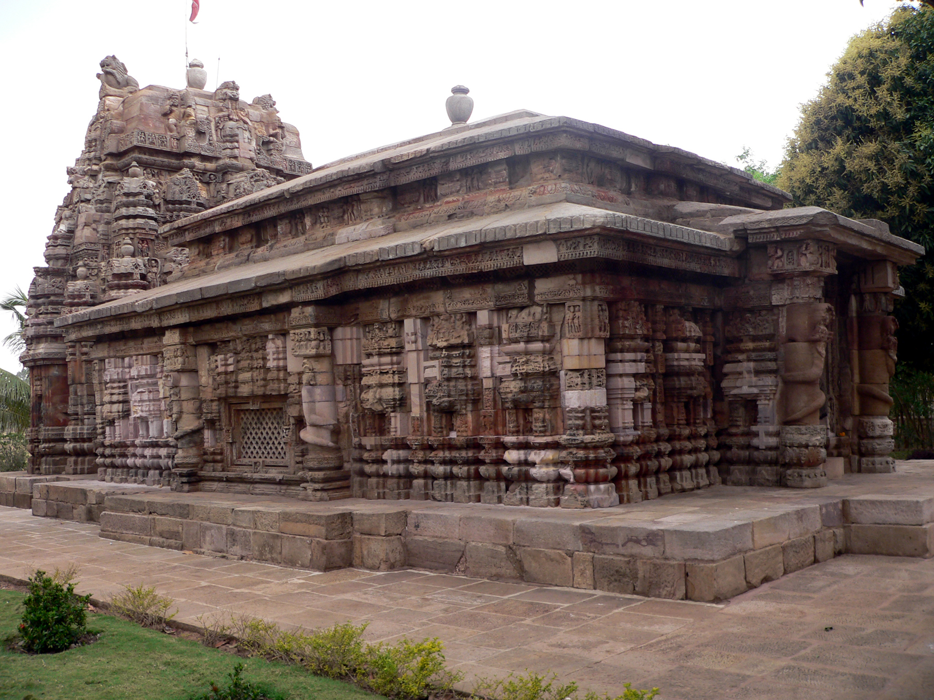

Slide 31
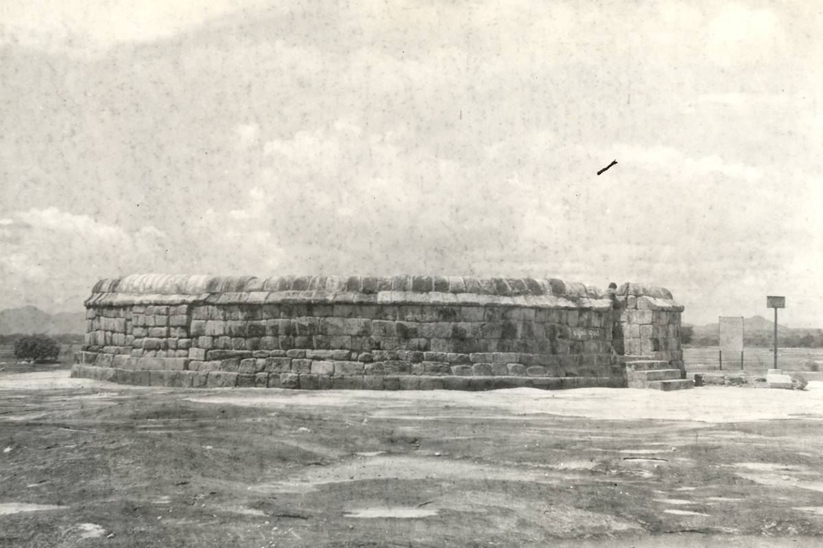

Slide 33
Thank You

