Slide 1
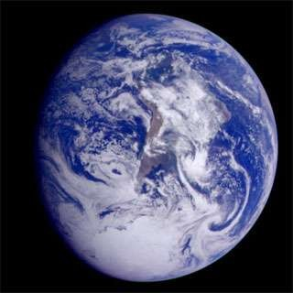

Slide 2
Terms
Atmosphere-The gases, droplets, and particles surrounding Earth’s surface.
Weather-Day to Day conditions of the atmosphere.
Climate-The statistical properties of the atmosphere, including measures of average conditions, variability, etc.
Climatology-The study of long term atmospheric conditions.

Slide 3
CRAZY FACT
-The total mass of the atmosphere is equivelant to 5.65 billion million tons.
“Understanding Weather and Climate”, Fifth Edition, Aguado and Burt, page 5

Slide 4
Vertical Structure
Troposphere-Lowest layer of the atmosphere. Where almost all weather takes place. Decreasing temperatures. Depth= 8 to 16km(3.6 to 10 miles).
Stratosphere-Second lowest layer of atmosphere. Very little weather occurs. Increasing temperatures. Depth=Approx. 20km(12 miles).

Slide 5
Vertical Structure CONT.
Mesosphere- Third layer in the atmosphere. Decreasing temperatures. Depth=Approx. 80km(50 miles).
Thermosphere- Outermost layer of atmosphere. Increasing temperatures. Depth=Begins at 80km

Slide 6
ADDITIONS
Tropopause-Transition zone where the temperature ceases to decrease.
Stratopause-Top of stratosphere, temperatures continue to increase.

Slide 7
ADDITIONS CONT.
Ozone Layer-Within the stratosphere where the gas, ozone, is abundant.
Mesopause-Very top of the mesosphere, continuing into the thermosphere.
Ionosphere-Extends from the upper mesopshere into the thermosphere.

Slide 8
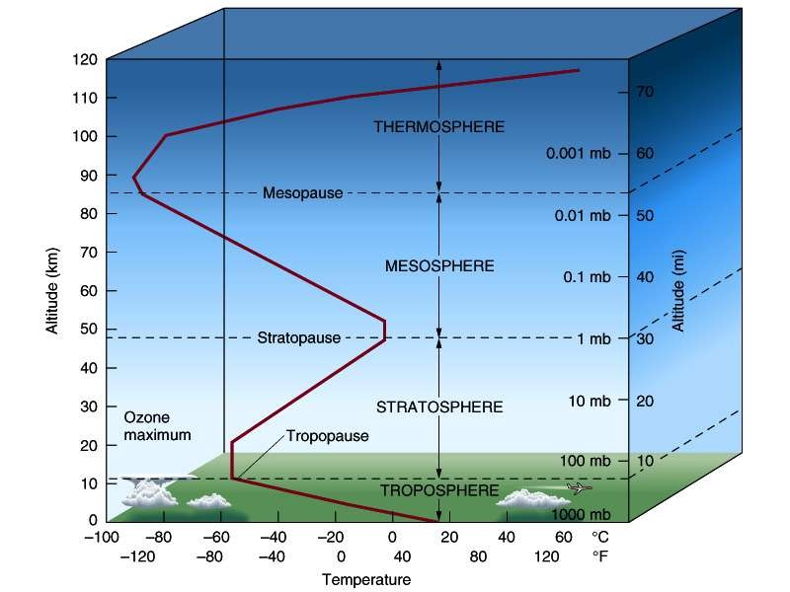
http://burro.cwru.edu/Academics/Astr201/Atmosphere/structure.jpg

Slide 9
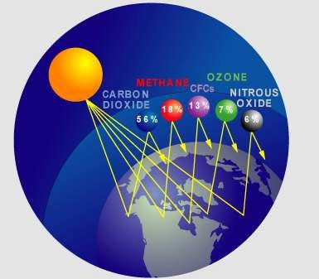
COMPOSITION OF ATMOSPHERE

Slide 10
Made up of:
-Mixture of invisible gases
-Large number of suspended microscopic particles and water droplets.

Slide 11
Relevant Terms
Homosphere-The lowest 80km of the atmosphere, which the relative abundance of the permanent gases is constant.
Heterosphere-The high atmosphere where gases are not well mixed but rather are stratified according to weight. Where lighter weighing gases are found.

Slide 12
Gases Making Up Atmosphere
Permanent Gases-Those gases whose relative abundance is constant within the homosphere.
Variable Gases-Gases present in amounts that vary greatly in abundance, either vertically, horizontal, or seasonal. Water vapor is the most important variable gas.

Slide 13
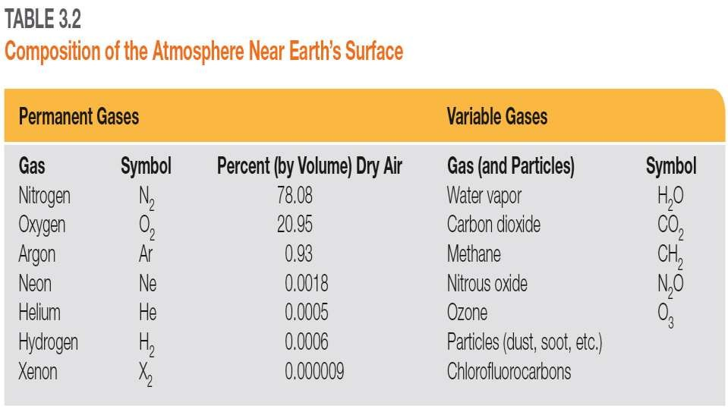
http://geogrify.net/GEO1/Images/FOPG/03T2.jpg

Slide 14
RESOURCES
Information from the book:
Aguado: Understanding Weather and Climate, Fifth Edition Copyright © 2010 Pearson Education, Inc.
Pictures on Page 1- planetgreen.discovery.com(left), windows2universe.org(right)
Atmosphere Structure picture-
http://burro.cwru.edu/Academics/Astr201/Atmosphere/structure.jpg
Composition chart- http://geogrify.net/GEO1/Images/FOPG/03T2.jpg
Slide 10 Picture - http://www.examiner.com/images/blog/replicate/EXID47225/images/cause s02.jpg

Slide 15
The End

