Slide 2
introduction
Leadership is the one of the most important function of management which involves directing, influencing & motivating employees to perform.
Leadership is an important subject for managers because of the critical role leaders play in a group and organizational effectiveness.

Slide 4
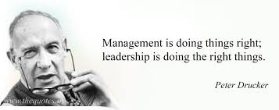
definition
According to Peter Drucker, “leadership is shifting of own vision to higher shifts, the raising of man’s performance to higher standards, the building of man’s personality beyond its normal limitations.”

Slide 6
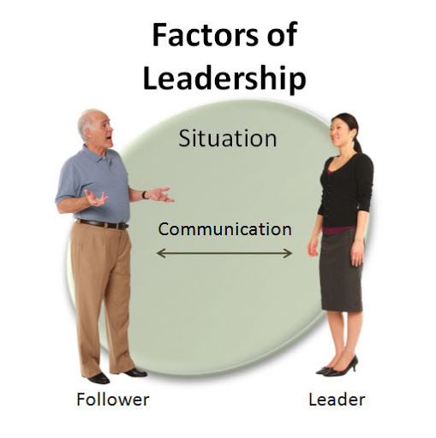
Four factors of leadership

Slide 7
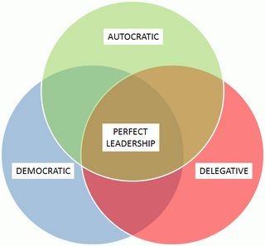
Styles of leadership

Slide 8
Theories of leadership
TRAIT THEORY
BEHAVIORAL THEORY
CONTINGENCY THEORY
SITUATIONAL THEORY

Slide 9
TRAIT THEORY
Trait theories of Leadership
Ambition and Energy
Desire to Lead
Honesty and Integrity
Self-Confidence
Intelligence
Job-Relevant Knowledge

Slide 10
Behavioral theory
These theories of leadership are based upon the belief that great leaders are made, not born.
Rooted in behaviorism, this leadership[ theory focuses on the actions of leaders not on mental qualities or internal states.
According to this theory, people can learn to become leaders through teaching and observation.
The behavior approach says that anyone who adopts the appropriate behavior can be a good leader.

Slide 11
Contingency theory
In this theory, the success of the leader is a function of various contingencies in the form of subordinate, tasks ,and/or group variables.
The leaders who are very effective at one place and time may become unsuccessful either when transplanted to another situation or when the factors around them change.

Slide 12
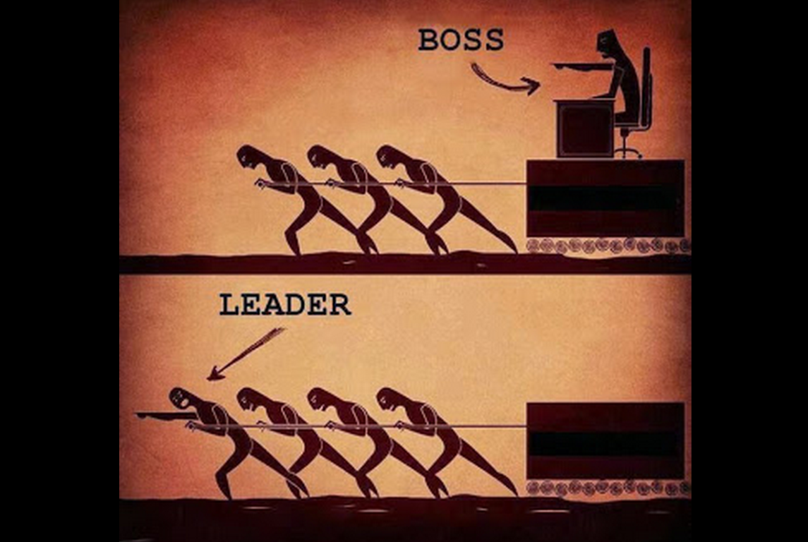
Who is a leader?
One that leads or guides.
One who is in charge or in command of others.
One who heads a political party or organization.
One who has influence or power, especially of a political nature.

Slide 13
Characteristics of Leadership
Empathy
Consistency
Honesty
Direction
Communication
Needs support from all

Slide 15
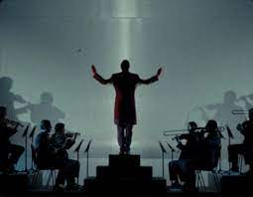
Initiates action
Motivation
Providing guidance
Creating confidence
Co-ordination
Effective planning
Inspiration & motivation.

Slide 16
Difference between
manager And Leader
Manager
Manage
Organize
Plans
Co-ordinate
Follow the vision
Evaluates
Facilitates
Budgeting
Leader
Inspire
Motivate
Coach
Establish Direction
Lead
Seek opportunities
Support
Empower

Slide 17
Role of a leader
A leader’s role is always to ensure his/her team achieves the task in hand, but an effective leader will also ensure they meet more subtle requirement.

Slide 19
Thank
you

